Slide 1

Best Practice
&
Effective Suicide Prevention
Nancy Buyle, MA, LPC, NBCC
School Safety/Student Assistance Consultant

Slide 2


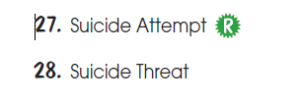
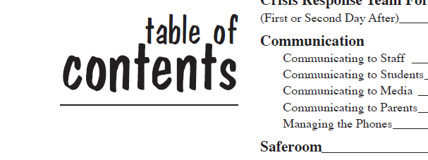


First things first
Notes:
Does your school have policies and procedures in place concerning suicide issues?
Are you aware of where you can locate these policies and procedures?
Does your school have an established crisis response team?
Do you know who is on the team?
Does your school have a crisis response plan that details what actions to take (interventions) if a student does threaten, attempt, or dies by suicide?
Have you been provided a copy of this plan?

Slide 3
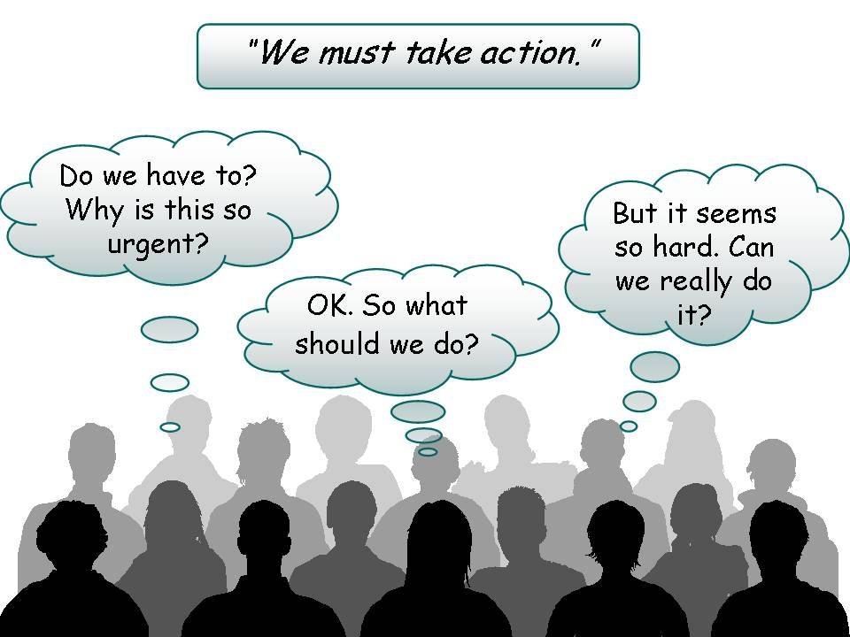
Notes:
Why do we have to? Because for every completed suicide Next slide

Slide 4


Attempts vs. Completions?
Notes:
Have Lynda tell her story about the papers
Among young adults ages 15 to 24 years old, there are approximately 100-200 attempts for every completed suicide.
Goldsmith SK, Pellmar TC, Kleinman AM, Bunney WE, editors. Reducing suicide: a national imperative. Washington (DC): National Academy Press; 2002.
Centers for Disease Control and Prevention. Youth Risk Behavior Surveillance—United States, 2009. Surveillance Summaries, June 4. MMWR 2010; 59(No. SS-5).

Slide 5
What Schools Can Do
Best Practice for Schools information
Suicide Prevention Programming
Notes:
Discuss Suicide PreventionProgram and best practice strategies for schools.

Slide 6
Resources
  Find out what they are
  Find out how to access them
  Educate students to use them
Notes:
An effective teacher training program needs to include:
risk factors and warning sign to detect potential suicide risk
how to make referrals when concerned about a potential suicidal student
ways to help students feel comfortable when seeking assistance
list of available supportive resources for students and staff
school policies on suicide prevention and intervention
understanding the importance of working as a team

Slide 7
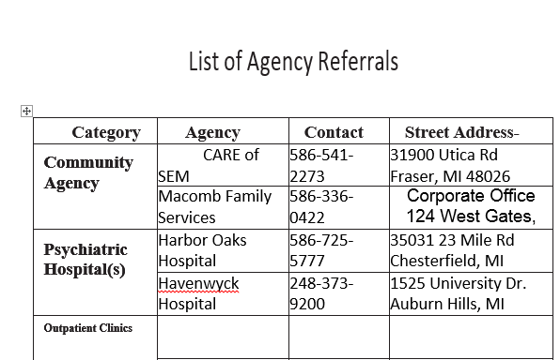
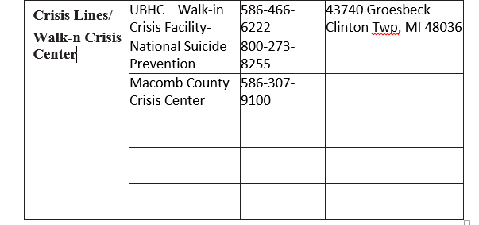

Slide 8




Get ready-set-go!—teacher training
Notes:
TEACHER TRAINING
is vital to the success of a implementing suicide prevention program
has a positive impact on comfort and confidence level—Teach your teachers…
Know what to do: Follow your schools procedures—launch a suicide prevention program yearly (sustain it throughout the year). Be aware of the guidelines your team has laid out. Be vigilant in looking for the warning signs and risk factors. Help build on protective factors for your students
Don’t leave the student alone: Arrange to have someone come to get the student, or ask the student to stay with you after class, do not rely on other students to transport suicidal student to counselor or sw
Use your schools support system: Get to know your counselors and sw’s. If you don’t know them already, become familiar with who they are. They are your support. They can assess the student and find proper care. If you are concerned about a student who is not necessarily suicidal, bring your concerns to the attention of the counselors/sw’s. This could be a suicide prevention intervention in and of itself.
Connect with parents/guardians: Establish good working relationships with parents. Encourage parents to be open with you about any concerns or trouble their student is having. Let them know you are willing to try and help. Then find the necessary help.

Slide 9






Programs school can use

Slide 10

Dennis Liegghio Presentation
Notes:
Dennis is a great resource to your schools. He will really take what you teach in the classrooms with the students and bring it home for them. He will reinforce in a very brain friendly way the importance of what you spent your time teaching.
In full disclosure, there are other options for schools that are free or low cost. Jason Foundation has curriculum on suicide prevention
The

Slide 11
Taking it back
Nancy Buyle, MA, LPC, NBCC
School Safety/Student Assistance Consultant
Notes:
2:00 to 2:15 Spend 15 minutes in your teams and discuss this checklist and timeline. Jot down some initial planning ideas that you have after reading the timeline.

Slide 12
Consultation
For Consultation,
Contact:
  Nancy Buyle at nbuyle@misd.net or 228-3439
Notes:
For questions or concerns about how to interpret meaning of flags or to explore interventions, please contact one of us.

Slide 13


Checklist & Timeline
Notes:
For the next 15 minutes we will discuss in our groups how to take this back to our buildings
Take a few minutes to complete as much as you can of the checklist and review the items on the timeline

Slide 14
Action Plan: Getting ready for Launch…
Things to consider:
  Who will be your point person?
  How often will you meet between now and March 21st?
  How will you provide gatekeeper training?
  How will you provide student education?
  What barriers or obstacles do you anticipate having to overcome?
Notes:
For the next 15 minutes, we wanted to allow you an opportunity to work in your teams to begin your action plan for launching a suicide prevention campaign. Keep in mind that brainstorming and discussing how to overcome potential obstacles or barriers now will help you when you get back to your buildings to get started on the work.
While you are working on your plan raise your hand if you have any questions.
The next two slides are some considerations for developing an implementation plan. Let’s look over the two slides really quickly and then you will have some time to work as a team. (we will leave the first slide up for 7 mins and the second slide up for 7mins.) If you are done discussing the considerations on the slide—type us a note in the question box. IF everyone is done, we will advance before the 7 mins. Is that fair?
Things to consider: Who will be your point person to set up the system—should not be the power school liaison? How often will you monitor EWS what about the flags—Think in terms of learning why the flag may have gone off and what interventions will be appropriate. expectations for use by Teachers, Administration, Counselor/SW’s.

Slide 15

Reach Out
Notes:
Any questions about this past section or anything in the training?
The start of the presentation we highlighted the importance of asking the question and talking to youth or adults openly about suicide.
I am ending this presentation with a video clip from Mayo that highlights the importance of anyone considering suicide to Reach out. I believe if we increase our efforts around these two ideas, we will reduce and hopefully eliminate youth suicide!
But after watching the video and before leaving, please fill out the intent to participate forms on the tables and the evaluation in your packet. We will be holding this training again soon and will make appropriate changes. Thanks for your time and energy and enjoy this video as you rap up!
https://www.youtube.com/watch?v=TIeBxeOxFyE

