Slide 1

Suicide and Youth
Nancy Buyle, MA, LPC, NBCC
School Safety/Student Assistance Consultant

Slide 2
Training Objectives:
Understand suicidal thinking
Become more aware of risk factors and warning signs of suicidal behavior
Acknowledge and overcome barriers to comprehensive suicide prevention in schools
Learn best-practice/effective suicide prevention guidelines

Slide 3
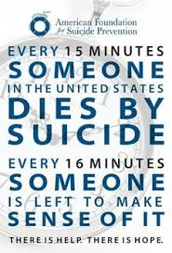
Notes:
Actually every 12.3 minutes someone dies by suicide and the ripple

Slide 4
Depression & Suicide by Academics
Notes:
7th grade seriously considered A/B 18% and D/F 43%
7th grade made a plan 11.6% A/B and 35.4% D/F
7th attempted A/B 7% and 25% D/F
2013 Michigan data Seriously considered11.4 males in high school and 20.6 females
Made a plan 2013 Michigan YRBS data 11.9 male, 17.5 female overall 14.7.

Slide 5

Facing the Facts
Seriously Considered Suicide
7th graders A/B 18% and D/F 43%
Notes:
2013 Michigan data 11.4 males in high school and 20.6 females
Data for college age seems very low given this data—but there have only been a few studies that looked at this and it is much more difficult to measure in college
It is true that the high school data reflects all youth including those who do not go on to college—but this is still a significant decrease.

Slide 6

Facing the Facts
Made a Plan
7th grade 11.6 A/B and 43% D/F
Notes:
2013 Michigan YRBS data 11.9 male, 17.5 female overall 14.7.

Slide 7
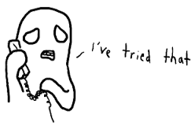
Facing the Facts
Attempted
7th graders A/B 7% and D/F 25%
Notes:
2013 YRBS Total 8.9
Male 7.3, Female 10.5
Black 10.7 White 7.5--Marked increase in suicide rates among African American/black students between 1993 and 2012 while rates among white youth decreased. Source Jama pediacrics May 18th 2015

Slide 8
Facing the Facts
In 2014, 42,773 people in the United States died by suicide. About every 12.3 minutes someone in this country intentionally ends his/her life.
Although the suicide rate fell from 1992 (12 per 100,000) to 2000 (10.4 per 100,000), it has been slightly raising since 2005. In 2014 the rate was 12.9
Notes:
many factors that contribute to the suicide rates, and we must work to change all of them to have an impact.
In 2014, there were 42,773 suicides, the rate is 12.9 per 100,000. slightly raising since 2015.
In 2014, the highest suicide rate (19.3) was among people 85 years or older. The second highest rate (19.2) occurred in those between 45 and 64 years of age. Younger groups have had consistently lower suicide rates than middle-aged and older adults. In 2014, adolescents and young adults aged 15 to 24 had a suicide rate of 11.6

Slide 9

15-24 Year Olds
Source:Centers for Disease Control and Prevention (CDC). Web-based Injury Statistics Query and Reporting System (WISQARS) [Online]. (2013). National Center for Injury Prevention and Control, CDC (producer). Available from URL: www.cdc.gov/injury/wisqars/index.html.
Notes:
Leading cause of death among college and university students
Three studies looked at the death rate among college and university and general population.
What puts them at RISK????

Slide 10
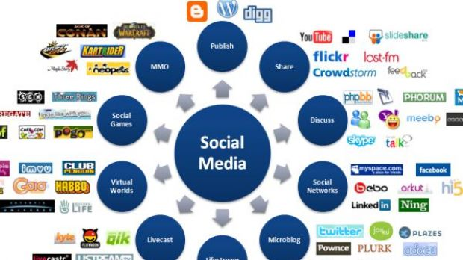
Notes:
Problematic to use “like” in social media middle school student put a suicide note on Twitter—I recall seeing several “likes”
DO NOT: use twitter or facebook to announce suicide deaths; do not give details about suicide, do not repost problematic messages,
Do not state that suicide is an epidemic; may encourage at risk youth to see themselves as part of the bigger story and could elevate their risk ,

Slide 11

Looking within
Notes:
Understanding your own thoughts and feelings about suicide and thinking in terms of what your teachers may think is important
To consider before you embark on providing this education to your students.
Take a few minutes to complete the Values Clarification Worksheet

