Slide 1
SUICIDE RISK FACTORS
WARNING SIGNS AND
PROTECTIVE FACTORS
Catherine Livingston, MA, LPC
Utica Community Schools
Henry Ford II High School
School Counselor

Slide 2
WHY IS IT ESSENTIAL THAT EDUCATORS ARE TRAINED
ABOUT YOUTH SUICIDE?
Given the
amount of time adolescents spend in school,
it is imperative that school faculty and staff
are educated about
risk factors
warning signs
protective factors
of suicidal behaviors.
Notes:
Typical school day is 7 hours, as specified in Section 101 of the State School Aid Act (MCL 388.1701), during the 2015-16 school year, all districts must provide at least 175 days of instruction, equals 1225 hours spent in school. Well, there

Slide 3
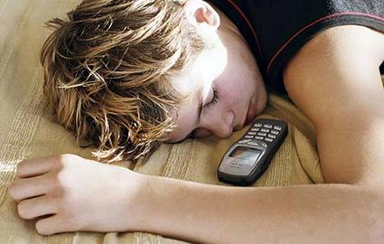
THINK ABOUT IT
8760 hours in a year
2,920 an average school aged student
spends sleeping (8 hours x 365 days)
5840 hours awake during the year
1225 hours spent in school equals to 20.9% of their awake time is spent in school

Slide 4
State Mandated Yearly Training (5 states)
State Mandated Training, Not Yearly (16 states)
State Encourages Training (16 states)..MICHIGAN
Other School Suicide Prevention Statutes (13 states)
House Bill 5154 (2015) instruction and professional development in warning signs for suicide and depression make mandatory
Notes:
American Foundation for Suicide Prevention
School Personnel Training Laws Overview (Updated 6/30/2014 )

Slide 5
While adolescent suicide
is not taken lightly
risk factors
warning signs
and
protective factors
are often
overlooked and mistaken.
Notes:
The need to continue training on teen suicide is important.
Share other infor

Slide 6
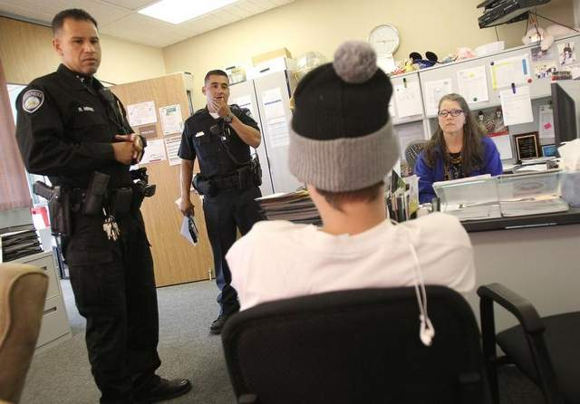
Recognize
The
Clues
Notes:
Research does show that suicidal youth tend to give evidence about their distress both verbally and through changing behaviors.
Being able to recognize these clues and knowing the factors and signs associated with adolescent suicide may help school staff prevent a student at risk for suicide from attempting and/or dying by suicide.
Many students will present some of the factors and signs, however not all will feel, act, or have ideas about suicide.

Slide 7
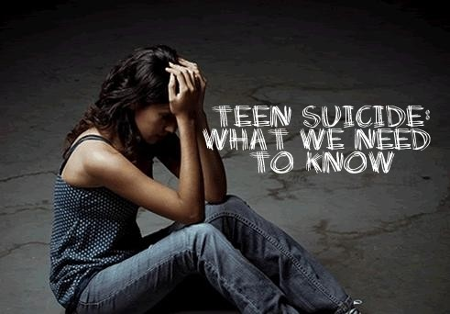
Notes:
It is important that we are knowledgeable of risk factors, protective factors and warning sign because they plays a key role in youth suicide prevention.

Slide 8
RISK FACTORS
characteristics that make it more likely that someone will consider, attempt or die by suicide
they can be considered "clues"
long term risk (i.e. a year to a life time)

Slide 9
Mental Health Disorder
Substance Abuse
Previous Attempts
Physical Abuse
Sexual Abuse
Conduct Disorder
Disruptive Disorder
Exposure to Suicidal Behaviors
Chronic Physical Sickness

Slide 10
RISK FACTORS THAT CAN BE DETECTED IN SCHOOL
Legal or Disciplinary Problems
Juvenile Delinquency
School Problem
Aggressive-Impulsive Behaviors
Being Homeless
Running Away From Home

Slide 11
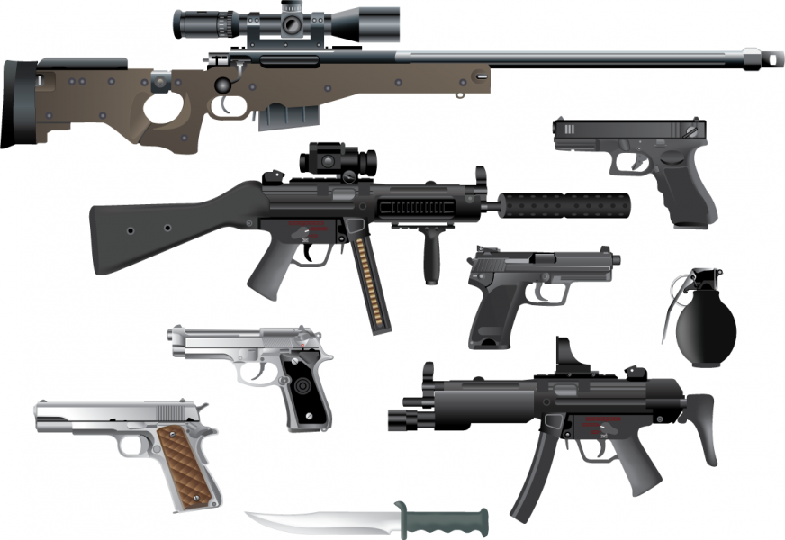
Notes:
The final risk factor I want to mention to you FIREARMS.
Firearms in the home make it 50% more likely that a youth will attempt

Slide 12
WARNING SIGNS
behaviors and characteristics that someone may harm himself or herself in the near future
These signs are considered "red flags“

Slide 13
VERBAL WARNING SIGNS
Talking about or making plans for suicide
Making statements about hopelessness, helplessness, worthlessness, or being "beyond help“
Giving verbal statements such as "I won't be a problem for you much longer," "Nothing matters," "It's no use," and "I won't see you again.”
Complaints about being a bad person or feeling "rotten inside"

Slide 14
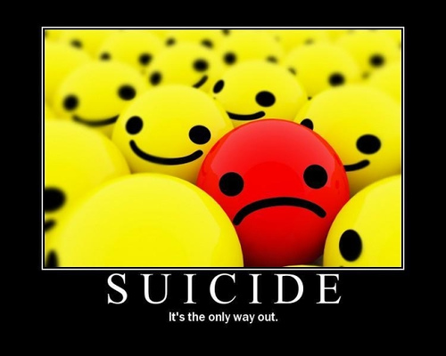
BEHAVIORAL WARNING SIGNS
Difficulty concentrating or decline in quality of school work
Withdraw from friends and family
Loss of interest in things once cared about
Loss of interest in pleasurable activities
Preoccupation with death
Giving away favorite possessions
Notes:
These sign can be seen in the school environment

Slide 15
MORE
BEHAVIORAL WARNING SIGNS
Exhibiting impulsivity such as violent behaviors/rebellious behaviors
Marked personality changes or serious mood changes
Change in eating habits and/or sleeping habits
Becoming suddenly cheerful after a period of depression-this may mean that the student has already made the decision to escape all problems by ending his/her life

Slide 16
PROTECTIVE FACTORS
factors that make it less likely that a someone will consider, attempt or die by suicide
factors that enhance the student to develop strong coping skills

Slide 17
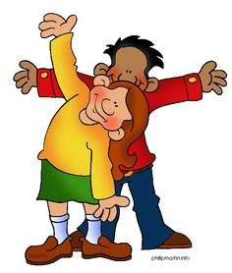
PROTECTIVE FACTORS
Stable living environment
Access to effective care for mental/physical/substance disorder
Responsibilities for others/pets
Religious or cultural belief
Family cohesion
Reduced access to means for suicidal behavior
Help-seeking behavior/advice seeking behavior
Impulse control
Notes:
Pets offer a soothing presence
Pets offer unconditional love and acceptance
Pets alter our behavior
Pets distract
Pets make us responsible
Characteristics believed to reduce the likelihood that someone will harm or kill him/herself by counterbalancing risk factors

Slide 18
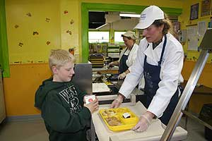
PROTECTIVE FACTORS IN SCHOOL
Perceived connectedness to the school
Support from teachers & other relevant adults
Positive relationships with other students/peers
Social integration/opportunities to participate
Sports, clubs and other activities
Problem solving/conflict resolution abilities
Good coping skills
Sense of worth/confidence

Slide 19
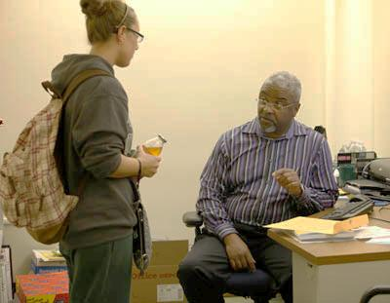
How
To
Respond
Notes:
HOW TO RESPOND TO A STUDENT AT RISK
1. Ask if they are ok or if they are having thoughts of suicide
2. Express your concern about what you are observing in their behavior
3. Listen attentively and non-judgmentally
4. Reflect on what they share and let them know they have been heard
5. Tell them they are not alone
6. Let them know there are treatments available that can help
7. Guide them to professional help
Who are the professionals in your building you can refer a student at risk
What other ways of responding can you think of

Slide 20
HOW TO RESPOND TO A STUDENT AT RISK
1. Ask if they are ok or if they are having thoughts of suicide
2. Express your concern about what you are observing in their behavior
3. Listen attentively and non-judgmentally
4. Reflect on what they share and let them know they have been heard
5. Inform them they are not alone and there are people that can help them
6. Guide them to professional help

Slide 21
Notes:
Now I would like to show you a teen suicide prevention video by Mayo Clinic
This is a video aimed for parents about asking your child about suicide.
I think this is a good video to empress on all of us that we can make a difference by being open to talking to and asking youth about their thoughts around suicide.
We must be direct when speaking with our students. Remember talking about doesn’t cause a student to become suicidal.
https://www.youtube.com/watch?v=3BByqa7bhto

Slide 22
A—Ask the “S” question
S—Seek better coping skills
K—Know how to make a safety plan
Notes:
So remember what ASK stands for Ask the s question….are you thinking about suicide
Seek better coping skills for the student and finally Know how to develop a safety plan.
Now we are going the ASK the question Activity—at your table with a partner—ask Are you thinking about suicide or are you thinking about killing yourself.
Ask just that way and make sure for the purpose of this activity when you are asked this question, you answer NO.
The purpose of this activity is to get you comfortable asking the S question.
Afterwards…So how did you do? Any feedback or comment about this activity?
Go to group activity if we need filler

