Slide 1
MISD & Local Planning Move to UC/PTPro-Assessment & Analytics
Dr. Jennifer Parker Kristina Martin
jparker@misd.net kmartin@misd.net

Slide 2
Training
PTPro
1 day (6 hours)
Assessment & Analytics
1 day (6 hours)
Special Topics
3 hours
Version 11.0 Update Certification
3 hours
Webinars & Technical Updates
1 hour (@6 sessions)
TtT
Network

Slide 3
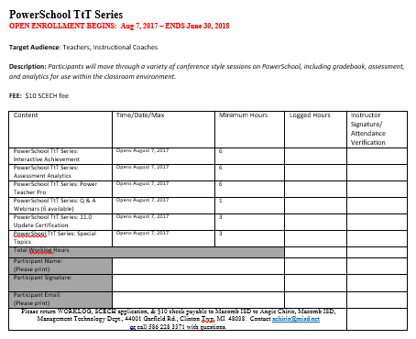
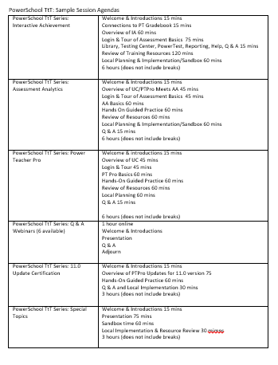
Passport Series

Slide 4
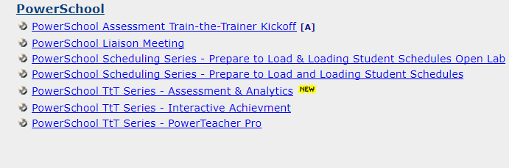
2 DAYS
REGISTER:
http://www.solutionwhere.com/misdtraining/cw/CourseByCateg.asp
Category: PowerSchool
Register in Courseware

Slide 5
Resources
MISD PS Web Page www.misd.net/psassessment
PS LiveAssist and PowerSource
Help Desk help@misd.net 586-228-3399
TtT network sharing PSAAtrainers@misd.net
Webinars
Communication of Technical Updates
MISD workgroups
RDI, PS Liaisons, ITAC, MTAC, FSI, etc.

Slide 6
 | UC-PTP/AA
Summer 2017 | Implementation for UC – update by MISD TtT identified/trained Define rollout Begin staff training – UC/PTP to get staff up and running for fall; AA option as appropriate PS Liaisons – setup & securities meetings - roles
Fall 2017 | Continue to train staff on UC, PTP, AA
Winter 2018 | Ongoing training AA Support for report cards Support for standards based grading
Spring 2018 | Ongoing training AA Support for report cards Support for standards based grading
Summer 2018 | Training and support for new staff or deeper learning
UC/PTP-AA
Timeline

Slide 7
 | PTG/IA
Summer 2017 | TtT identified/trained Define rollout Begin staff training PS Liaisons – setup & securities meetings - roles
Fall 2017 | Train staff on IA (Application tray) Trimester considerations
Winter 2018 | Implementation support Transition planning Semester considerations Support for report cards Support for standards based grading
Spring 2018 | Implementation support Transition planning
Summer 2018 | Transition to UC/PTP/AA Train-the-trainer and begin UC/PTP-AA Timeline
PTG/IA
Timeline

Slide 8
Local Planning
Training
Implementation
Evaluation

Slide 9
Training | District Planning
Who: Describe Personnel / staff dedicated to the ongoing support of this project
What: Describe training, resources, and outcomes you hope to cover during the coming year
Where: Explore available workspace for training and ongoing support.
When: Review PD Calendar at the local level. Determine what district PD days, local building/staff meetings, PLC, Department meetings, or other collaborative times are available to implement a training agenda.
Why: Prepare an introduction for staff on why the district is moving in this direction. Consider how will this initiative support and enrich the existing infrastructure.
How: Draft a timeline for implementation, describe logistics of the Train-the-Trainer network and considerations for building, staff, and ongoing training/support.

Slide 10
Implementation | District Planning
What are the implementation supports (i.e., coaching; prompting; implementation partners)?
How will the implementation supports be established and maintained (i.e., observation and feedback; modeling of the practice; planned co-implementation of the practice; shared use of fidelity tools with discussion)?
Who will be responsible?
When and how often will the implementation supports be provided?
What resources are needed?

Slide 11
Evaluation | District Planning
What are the intended outcomes of implementing the practice/innovation?
How will we evaluate the outcomes? (i.e. what data sources will we use?)
How will we know if we are successful?
Who will be reviewing the data?
When and how often will the data be reviewed?
What resources are needed?

Slide 12
Q & A
Dr. Jennifer Parker Kristina Martin
jparker@misd.net kmartin@misd.net
MISD Help Desk 586-228-3399
C. Kreucher, K. Depaolis, N. Drouillard

