Slide 1
Macomb ISD (MI) PowerSchool TtT – Assessment/Analytics
Sam Sale
Sam.sale@powerschool.com
Room MI/SU

Slide 2
Agenda – UC Assessment (DAY 2)
Welcome & Introductions 15 mins
UC/ PTPro meets AA - Login & Tour 75 mins
Navigating the Dashboard
Viewing Student Pages
Keeping Parents Informed
~Break~
AA Basics 75 mins
Items and Assessments
Student Login and Testing
Viewing and Responding to Student Progress
Live Assist
~LUNCH~
Hands-On Guided Practice 120 mins
Review of Resources 30 mins
Q & A and District/ISD Planning 30 mins

Slide 3
Login and Tour

Slide 4
Navigating the Dashboard

Slide 5
Calendar Review

Slide 6
Progress Analysis

Slide 7
Assignment Review

Slide 8
Activity Feed
Add an activity directly from the Dashboard or click Communication on the Navigation menu.

Slide 9
Take Attendance
In session
Not in session
Dashboard > Class selector menu

Slide 10
Viewing Student Pages

Slide 11
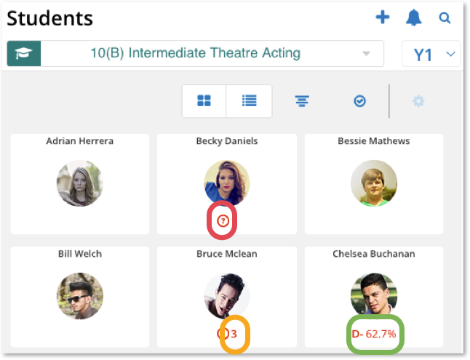
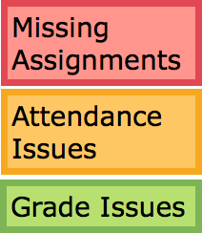
Early Warning Information
Dashboard > Students

Slide 12
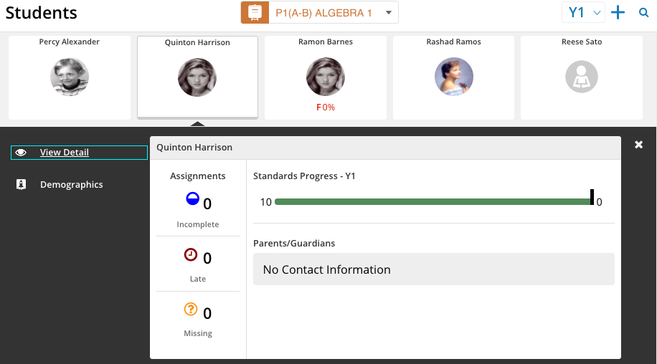
Student Quick View
Dashboard > Students

Slide 13
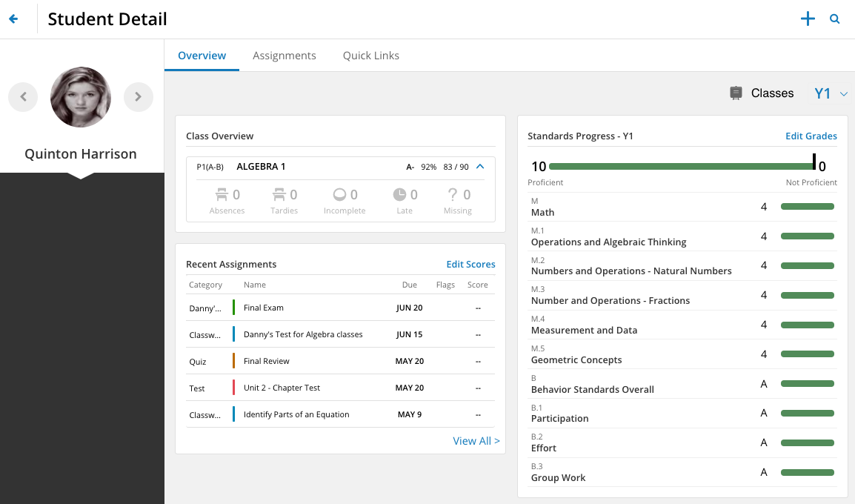
Student Detail
Dashboard > Students > View Detail

Slide 14
Keeping Parents Informed

Slide 15
Communicate with your “Customers”
Unified Classroom contains several tools to communicate with students and parents.
Communication: Activity Feed
Calendar: Events
Analysis: Reports

Slide 16
Communicate with the Activity Feed
Use the Activity Feed to remind students and parents about upcoming events:
Assignments
School activities
Class projects
Schedule changes
Permission slips
Fees
Dashboard > Communication

Slide 17
Manage the Calendar
Add an event – Public and viewable in the student and parent portals
Add a personal reminder – Private and viewable by only the teacher
Dashboard > Calendar

Slide 18
Assessment / Analytics Basics

Slide 19
Items and Assessments

Slide 20
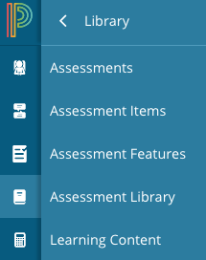
Create a Formative Assessment
Use to view, create, edit, or delete assessments
Use to view, create, edit, or delete assessment items that contain questions, associated standards, features, and answer choices
Use to view, create, edit, or delete features (i.e. passages, images, videos, etc.)
Dashboard > Library

Slide 21
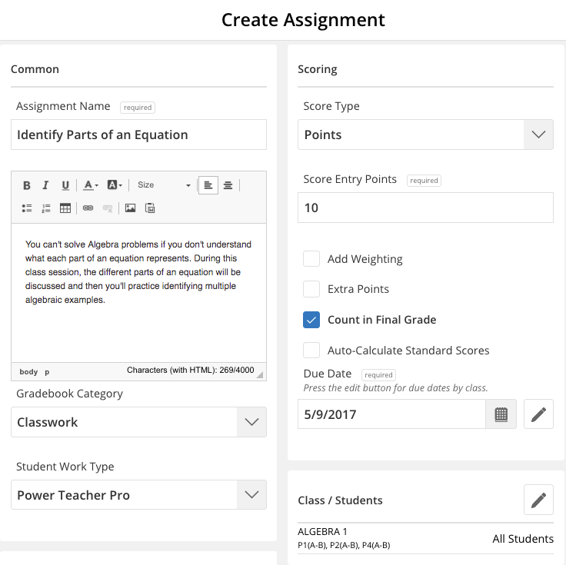
Create an Assignment
Dashboard > + Global Create

Slide 22
Create Assignment Sections
1
Add Basic Information
2
Determine Scoring Options
3
Select Which Class or Students
4
Associate Standards
5
Publish the Assignment
Notes:
enter notes

Slide 23
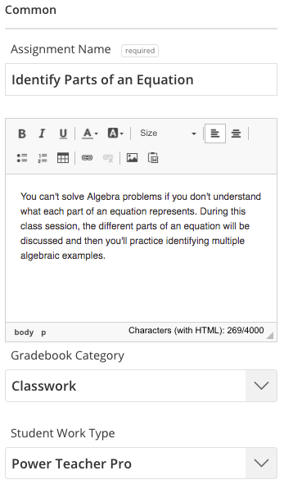
1
2
3
4
5
Add Basic Information
Assignment name and description
Gradebook category
Student work type
Notes:
enter notes

Slide 24
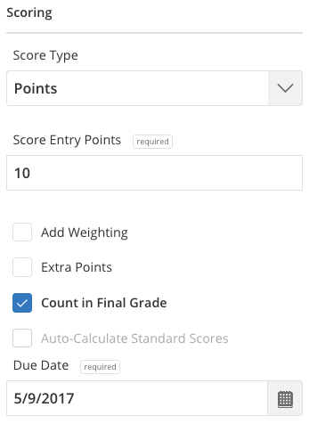
1
2
3
4
5
Determine Scoring Options
Score Type
Score Entry Points
Due Date
Notes:
enter notes

Slide 25
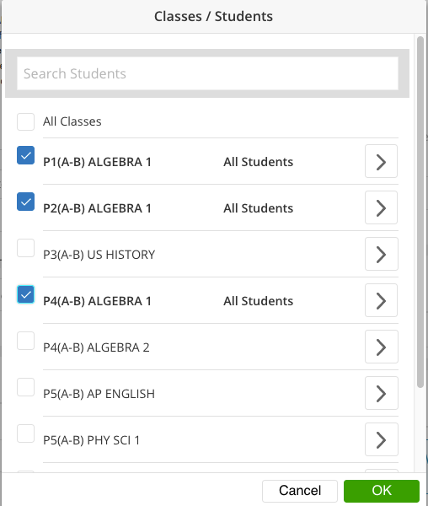
1
2
3
4
5
Select Which Class or Students
Select a class or multiple classes
Add or exclude students
Notes:
enter notes

Slide 26
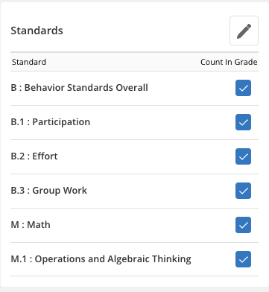
1
2
3
4
5
Associate Standards
Add new standards
Edit standards
Notes:
enter notes

Slide 27
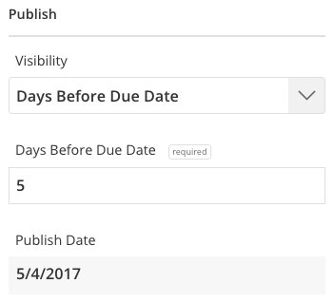
1
2
3
4
5
Publish the Assignment
Default set to Immediately
Add date and additional information for other options
Notes:
enter notes

Slide 28
Student Login and Testing

Slide 29
Viewing and Responding to Student Progress

Slide 30
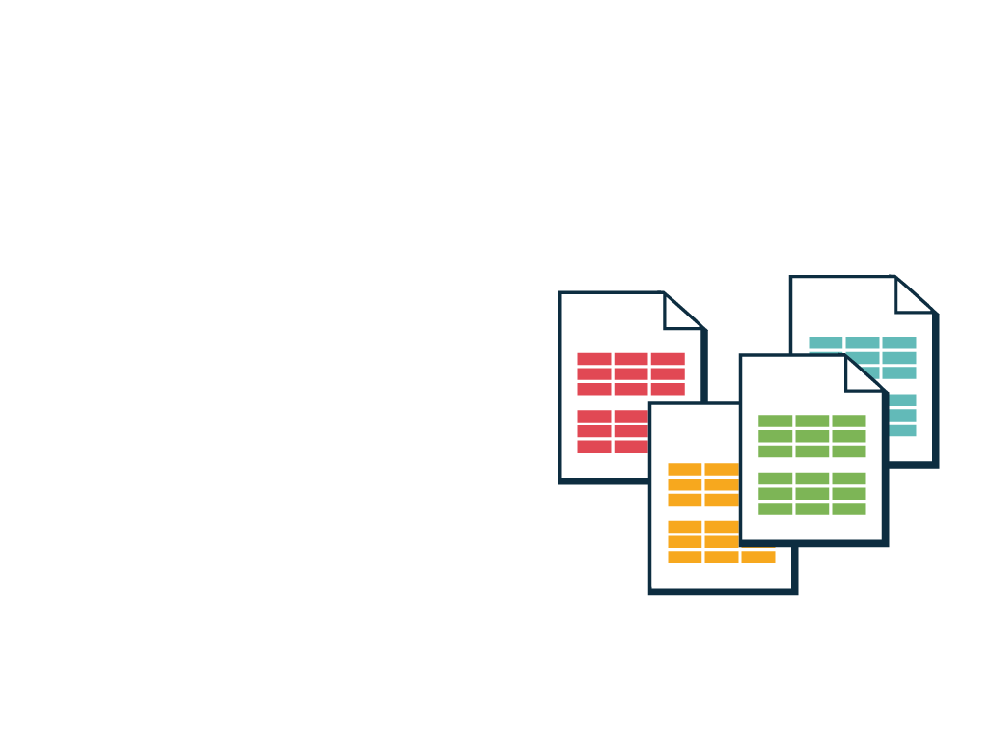
Generate a Report
Individual Student Report
Assignment Report
Scoresheet Report
Student Roster
PT Portal Reports
Analysis > Reports

Slide 31
Prepare for an Upcoming Parent Conference
Analysis > Reports > Select a report name

Slide 32
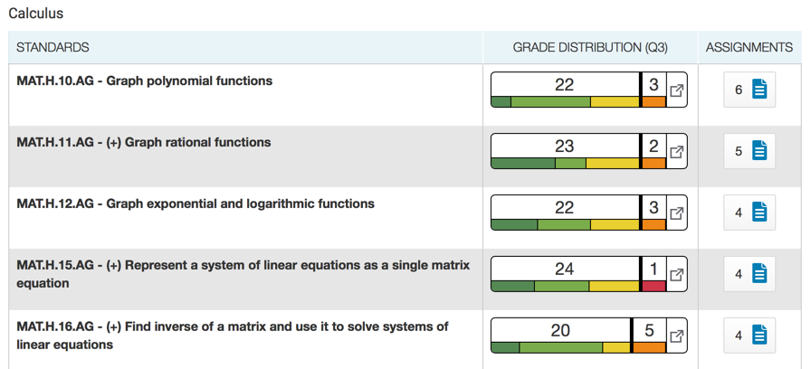
Standards Progress
View the distribution of course standards grades for a class for the selected reporting term.
Analysis > Standards Progress

Slide 33
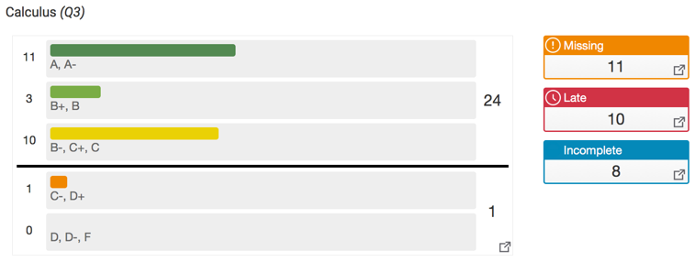
Traditional Progress
View the distribution of traditional grades for a class for the selected reporting term.
Analysis > Traditional Progress

Slide 34
Live Assist

Slide 35
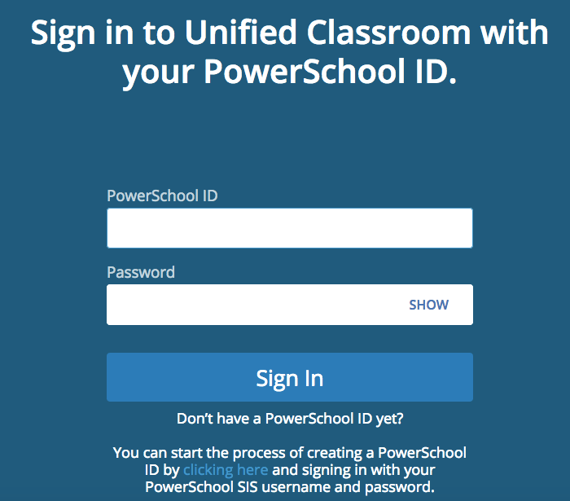
Before Creating a PowerSchool ID

Slide 36
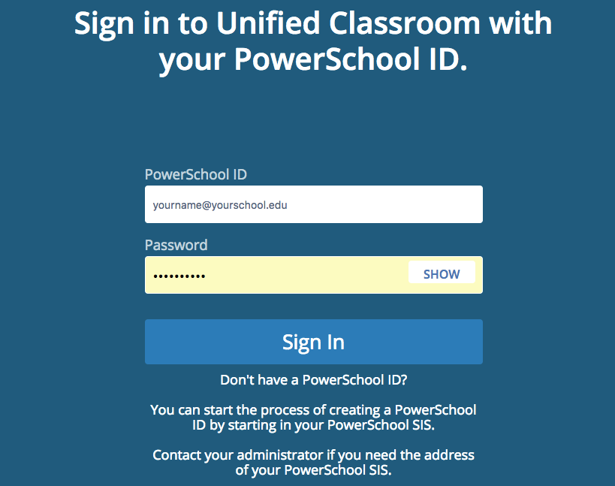
After Creating a PowerSchool ID

Slide 37
Logging In
(Note – using your OWN credentials)
https://classroom.powerschool.com
Teacher Username: abram1-pstrain6@powerschool.com
Password: globalaccount
Student Username: ag1student34-pstrain6
Password: globalaccount

Slide 38
Lunch Break!

Slide 39
Hands On Guided Practice: Using Unified Classroom Assessment Quick Reference Card

Slide 40
Review of Resource and LIVE ASSIST

Slide 41
General Q&A / Planning

