Slide 1
Macomb ISD The Unified Classroom
Josh Deegan
Account Executive
Matt Childers
Solution Engineer

Slide 2
Agenda
Welcome and Introductions
The Unified Classroom Dashboard
Assignments & Grading: PowerTeacher Pro
PowerSchool Assessment
PowerSchool Analytics
Help
Hands On Activity
Notes:
enter notes

Slide 3
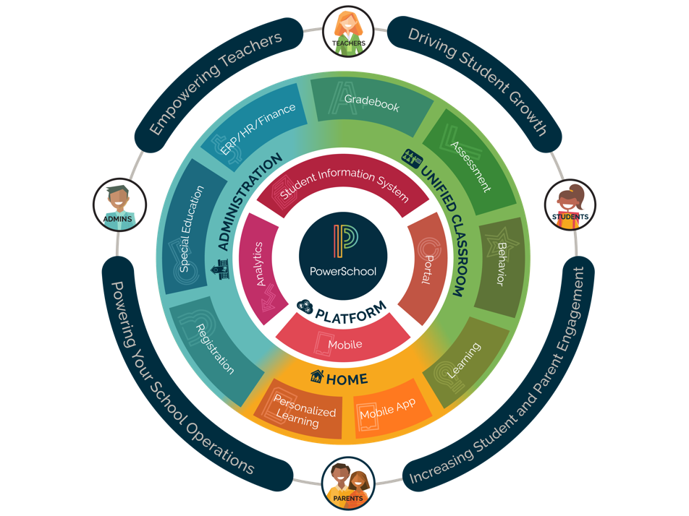

Slide 4
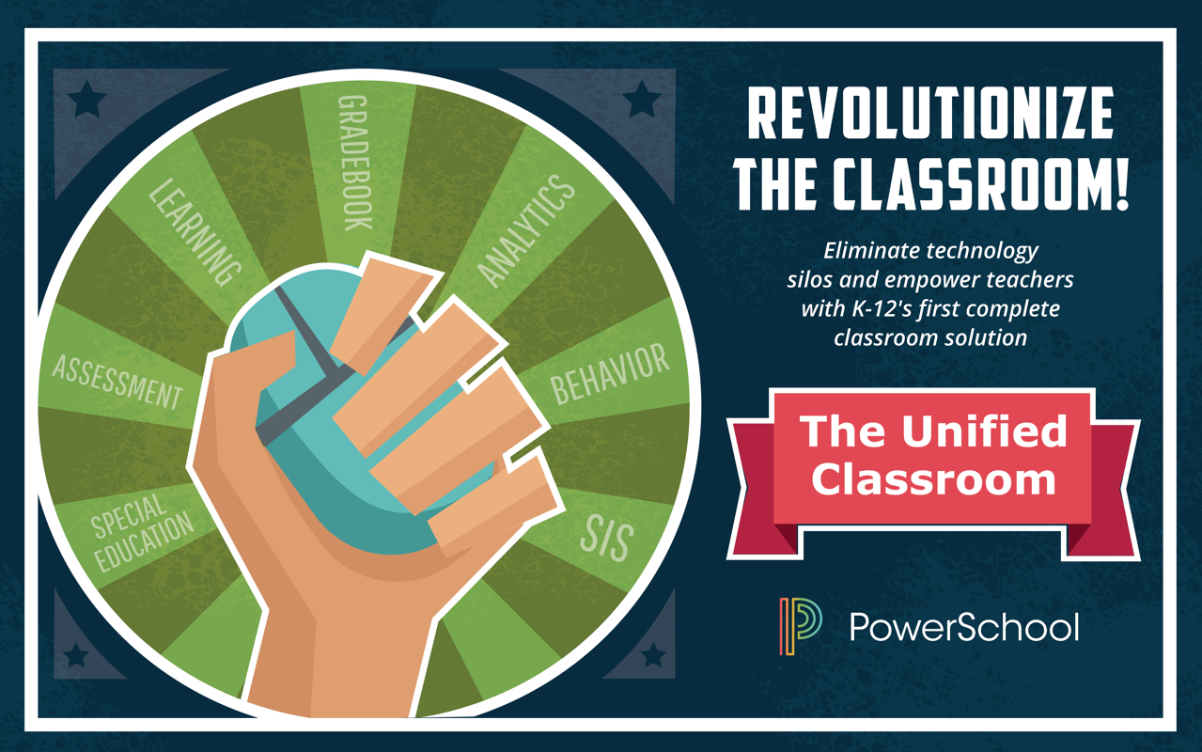

Slide 5
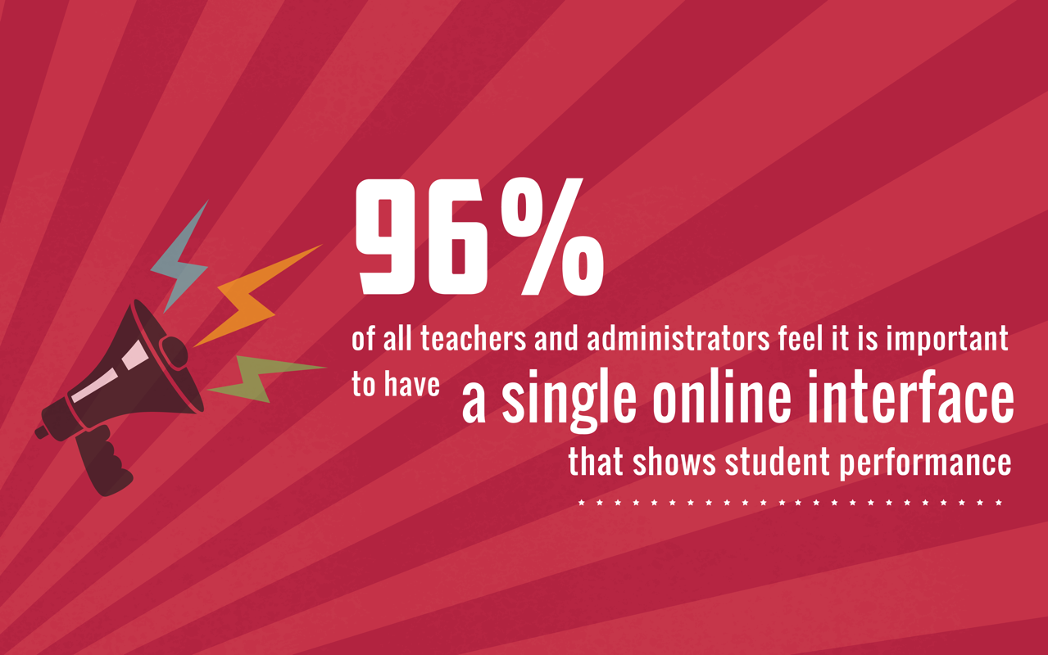
Notes:
Based on PowerSchool survey conducted May 2016 by an independent agency. Respondents did not know PowerSchool commissioned the survey.

Slide 6
Teachers Face Too Many Product Silos
Collaboration
Assignments
Standardized Grading
Blended Learning
Student Progress
Attendance
Lesson Plans
Intervention & Behavior
Formative Assessments

Slide 7
What If There Were No Silos?
PowerSchool’s Unified Classroom breaks down traditional product barriers and lets teachers teach.
Notes:
PowerSchool’s vision for the unified classroom is to bring together all of our solutions so that teachers no longer have to think about product silos. Instead, we will deliver seamless functionality that erases the boundaries between programs and lets teachers focus on teaching.

Slide 8
Navigating the Dashboard

Slide 9
Calendar Review

Slide 10
Progress Analysis

Slide 11
Assignment Review

Slide 12
Activity Feed
Add an activity directly from the Dashboard or click Communication on the Navigation menu.

Slide 13
Take Attendance
In session
Not in session
Dashboard > Class selector menu

Slide 14
Creating an Assignment

Slide 15
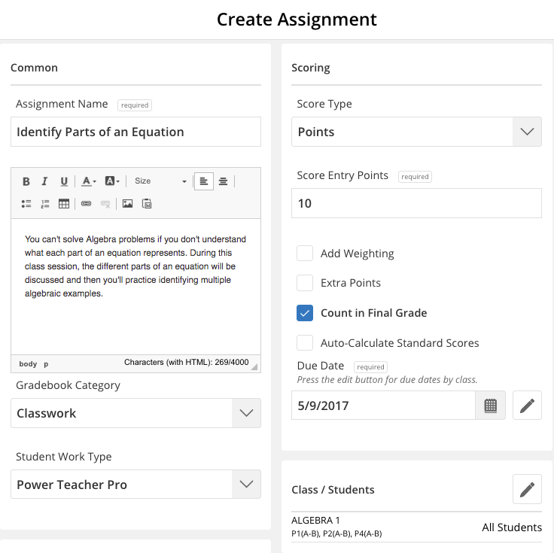
Create an Assignment
Dashboard > + Global Create

Slide 16
Create Assignment Sections
1
Add Basic Information
2
Determine Scoring Options
3
Select Which Class or Students
4
Associate Standards
5
Publish the Assignment
Notes:
enter notes

Slide 17
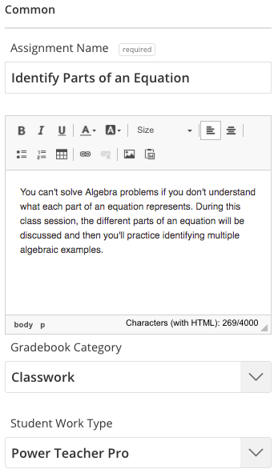
1
2
3
4
5
Add Basic Information
Assignment name and description
Gradebook category
Student work type
Notes:
enter notes

Slide 18
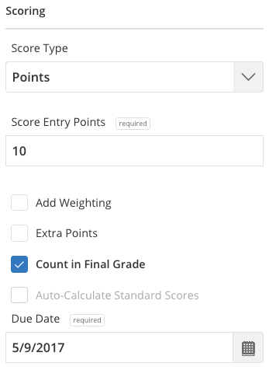
1
2
3
4
5
Determine Scoring Options
Score Type
Score Entry Points
Due Date
Notes:
enter notes

Slide 19
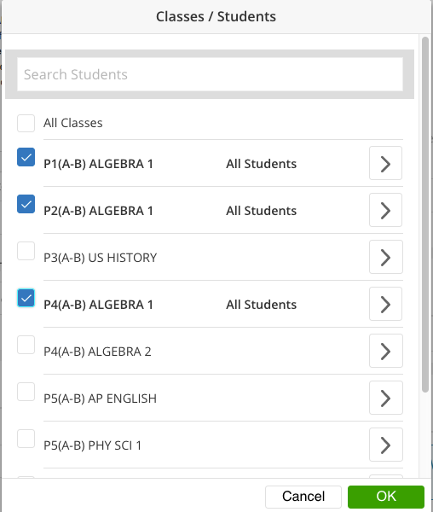
1
2
3
4
5
Select Which Class or Students
Select a class or multiple classes
Add or exclude students
Notes:
enter notes

Slide 20
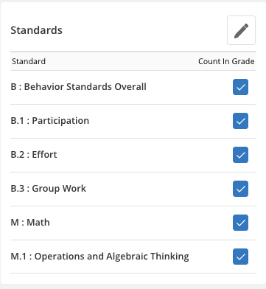
1
2
3
4
5
Associate Standards
Add new standards
Edit standards
Notes:
enter notes

Slide 21
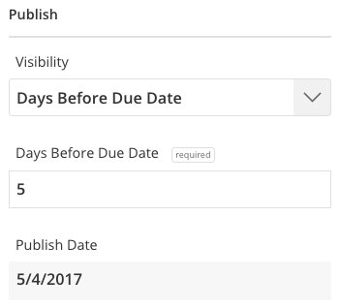
1
2
3
4
5
Publish the Assignment
Default set to Immediately
Add date and additional information for other options
Notes:
enter notes

Slide 22
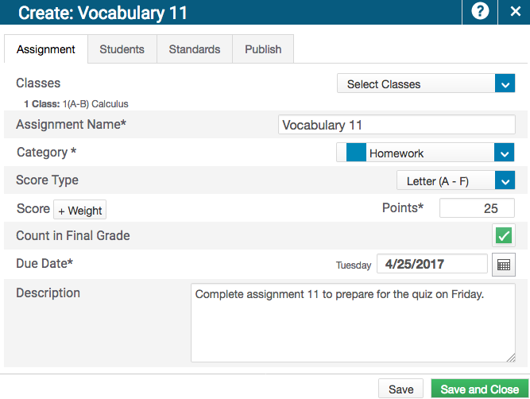
Creating Assignments
Create an assignment for one, some, or all of your students or classes
Align standards to an assignment
Define when an assignment is published

Slide 23
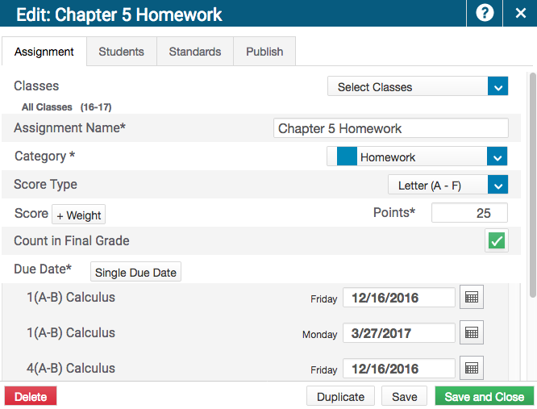
Duplicating Assignments
Duplicate new or existing assignments
Duplicate assignments for multiple classes
Use different due dates for different classes

Slide 24
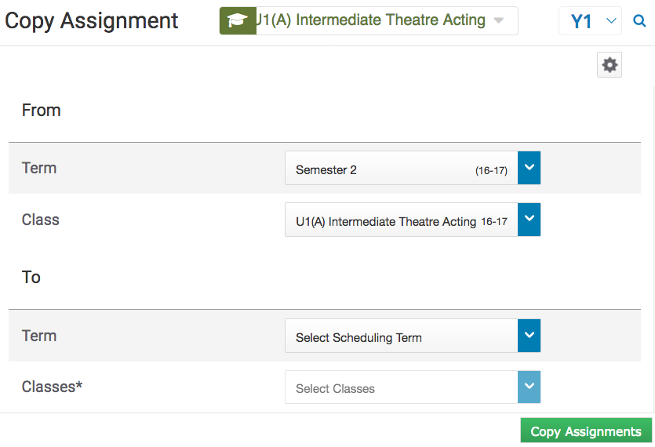
Copying Assignments
Copy one, some, or all of the existing assignments in a selected term and class to other terms and classes.

Slide 25
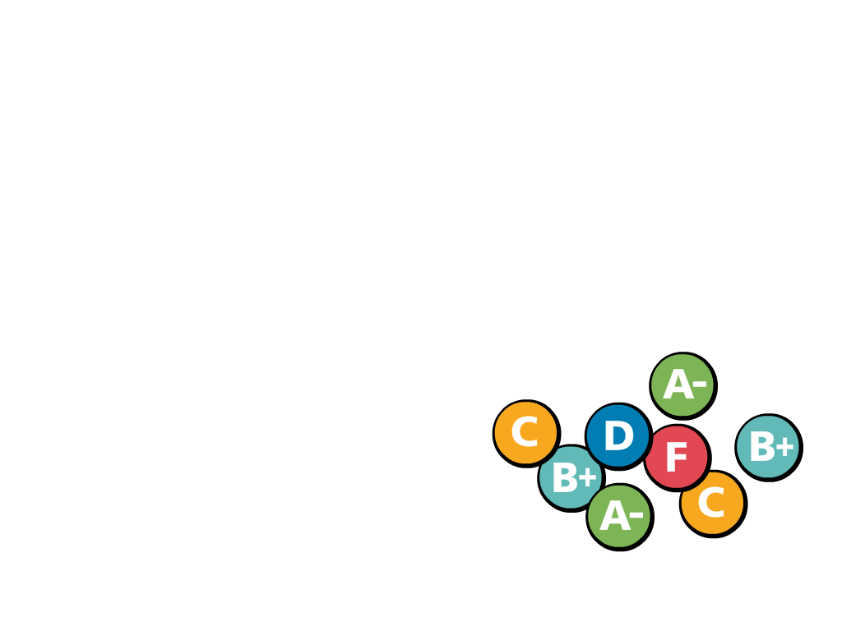
Working with Grades
Entering scores
Using the Score Inspector
Filling scores
Adding comments
Marking assignments

Slide 26
Entering Scores: Options
Mark or score assignments using the following options:
Direct entry
Score Inspector
Flags (score indicators)
Special codes
Hot keys (keyboard shortcuts)
Comments
Fill scores, flags, and comments

Slide 27
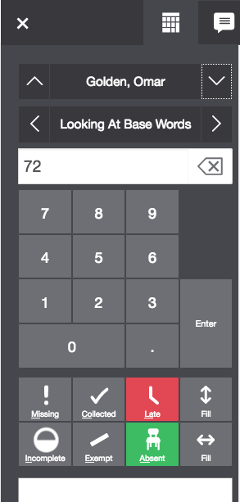
Using the Score Inspector
Why use the Score Inspector?
Enter and edit scores
Fill scores
Enter comments
Fill comments
Use flags (missing, collected, late, incomplete, exempt, and absent)
Use special codes

Slide 28
Filling Scores

Slide 29
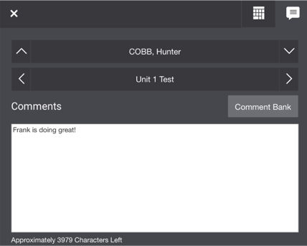
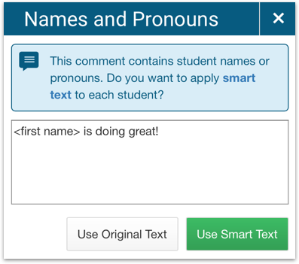
Adding Comments
Enter comments manually or use the comment bank
Use the smart text feature to personalize comments for one or more students

Slide 30
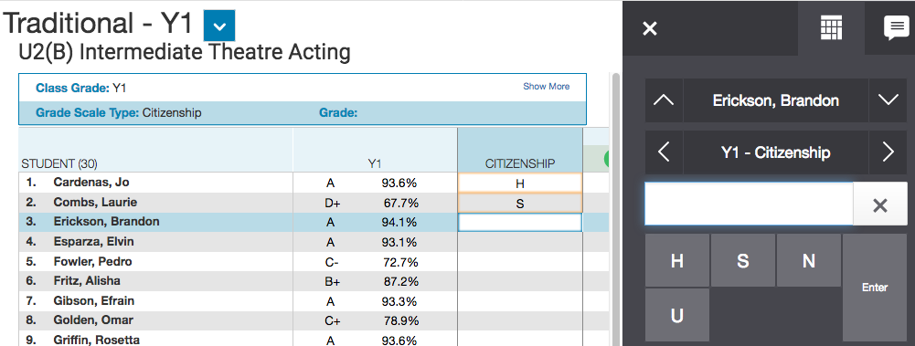
Entering Citizenship Scores
If enabled, enter citizenship scores that can be printed on students’ report cards.

Slide 31
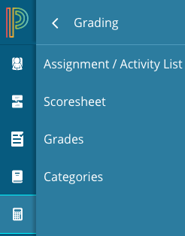
Marking Assignments
Mark or score assignments using the following methods:
Score a single assignment on the Assignments page
Use the Scoresheet to score multiple assignments

Slide 32
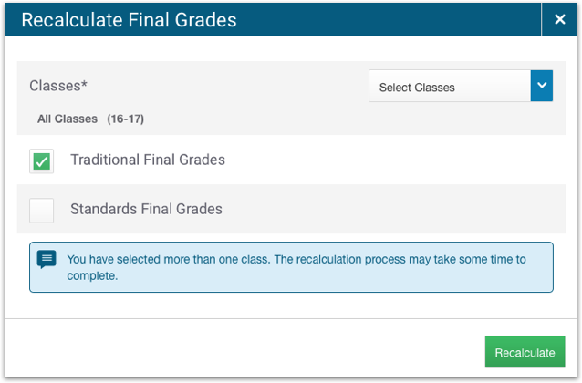
Recalculating Final Grades
Recalculate final grades to ensure that any calculation changes administrators may have made appear in your gradebook.
Grading > Scoresheet > Gear icon > Recalculate Final Grades

Slide 33
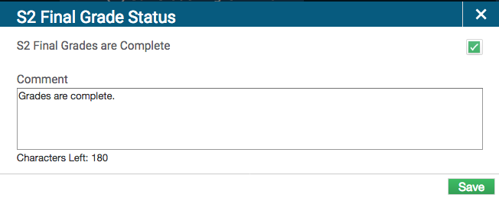
Indicating Final Grade Readiness
Grading > Grades > Final Grade Status

Slide 34
Viewing Student Progress

Slide 35
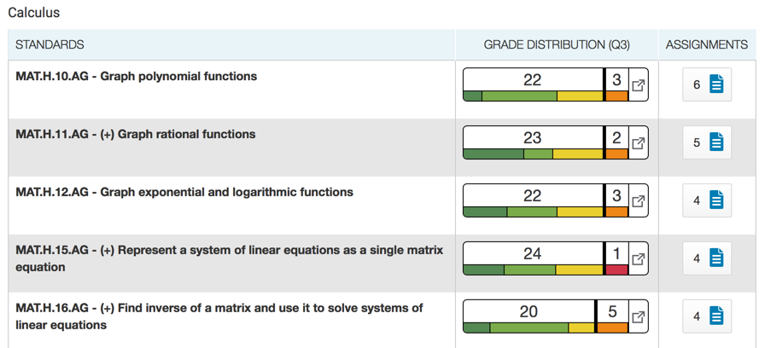
Standards Progress
View the distribution of course standards grades for a class for the selected reporting term.
Analysis > Standards Progress

Slide 36
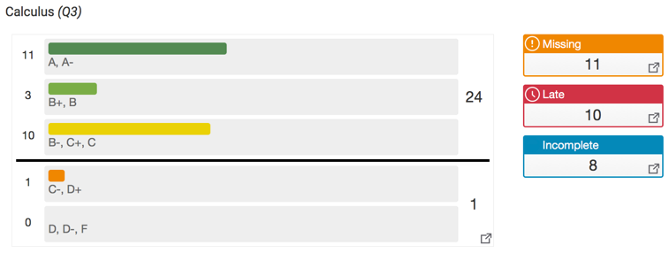
Traditional Progress
View the distribution of traditional grades for a class for the selected reporting term.
Analysis > Traditional Progress

Slide 37
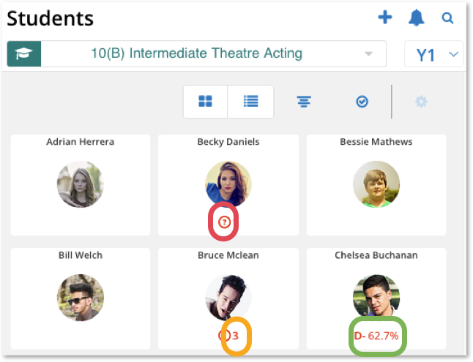
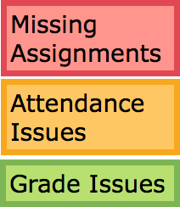
Early Warning Information
Dashboard > Students

Slide 38
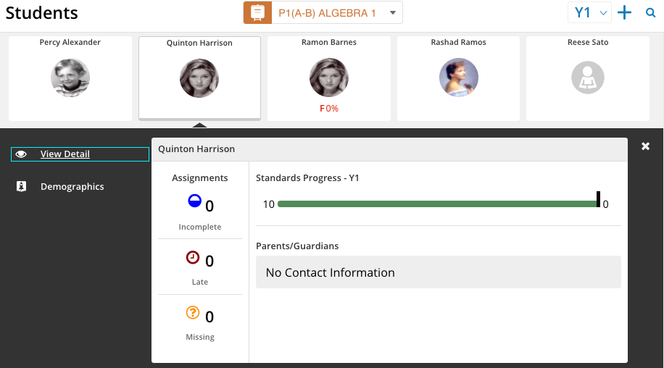
Student Quick View
Dashboard > Students

Slide 39
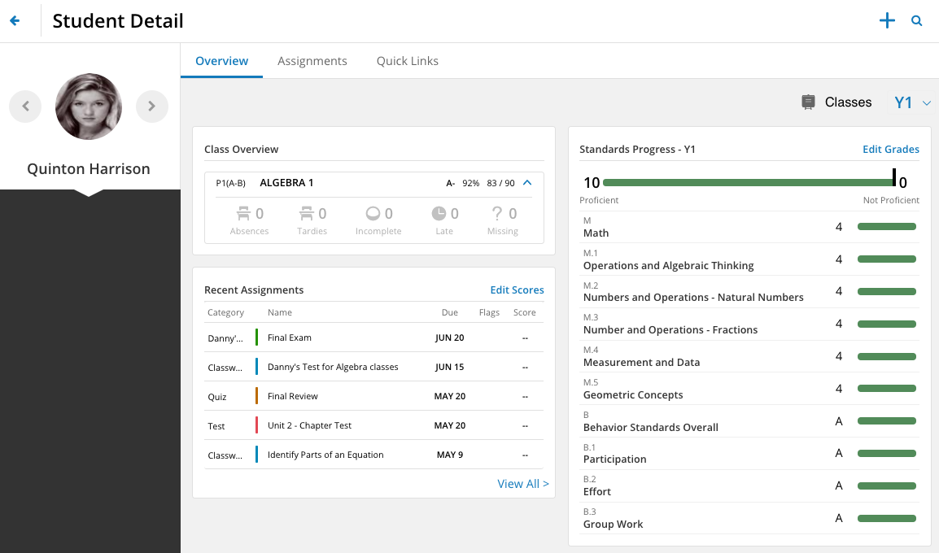
Student Detail
Dashboard > Students > View Detail

Slide 40
PowerSchool Assessment

Slide 41
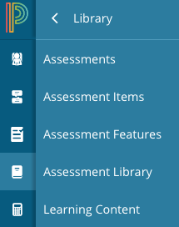
Create an Assessment
Use to view, create, edit, or delete assessments
Use to view, create, edit, or delete assessment items that contain questions, associated standards, features, and answer choices
Use to view, create, edit, or delete features (i.e. passages, images, videos, etc.)
Dashboard > Library

Slide 42
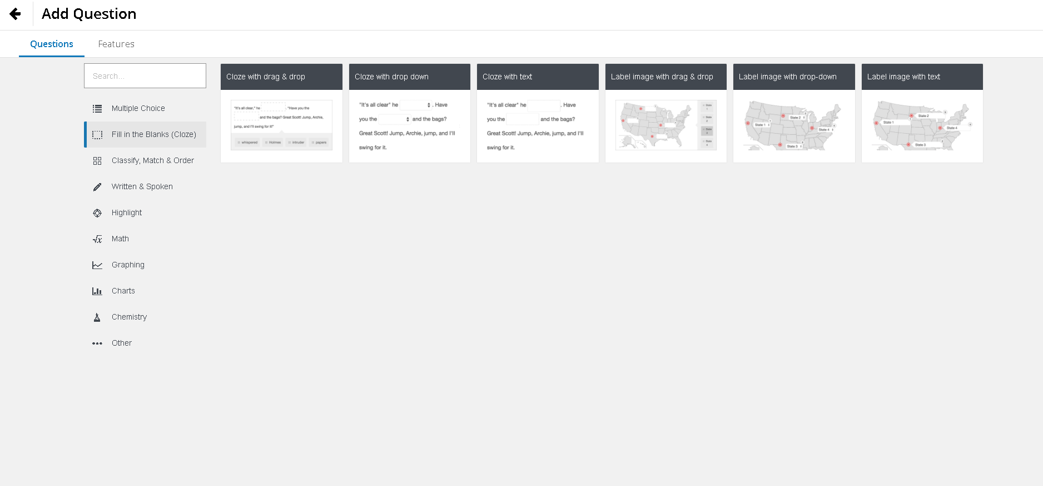
50+ Item Types: Standards Aligned Items

Slide 43
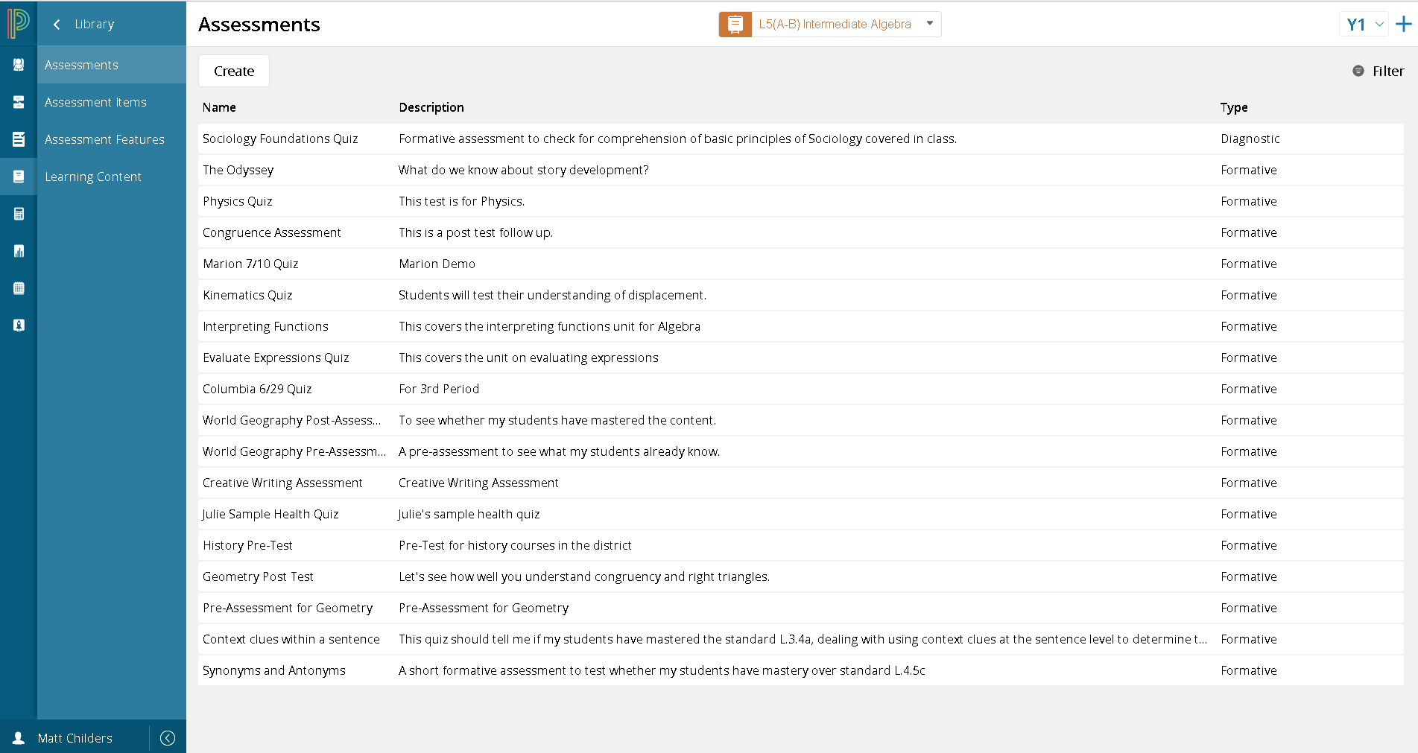
District Populated Assessment Library

Slide 44
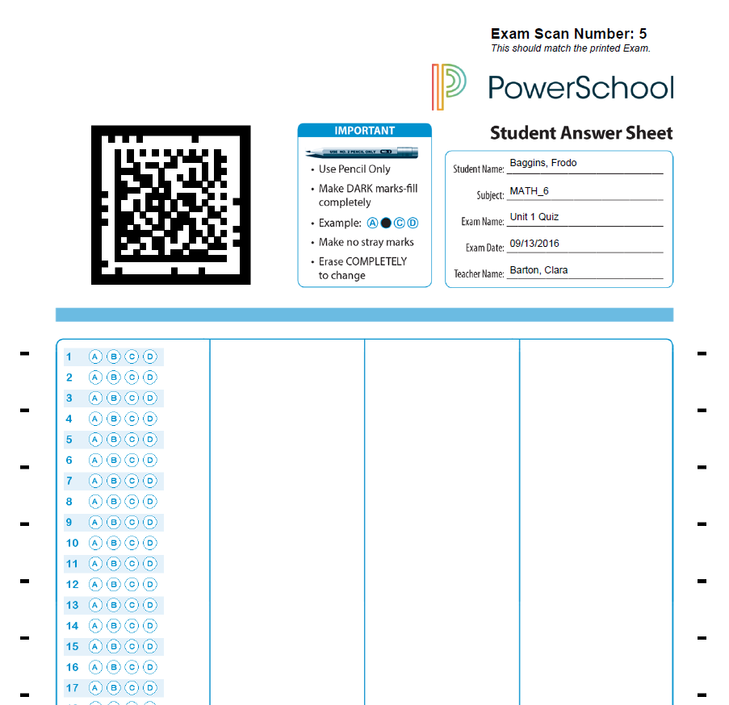
Paper/Pencil Options
Four choice multiple choice
Coming in July
Advanced(Macomb) Options
Coming in August

Slide 45
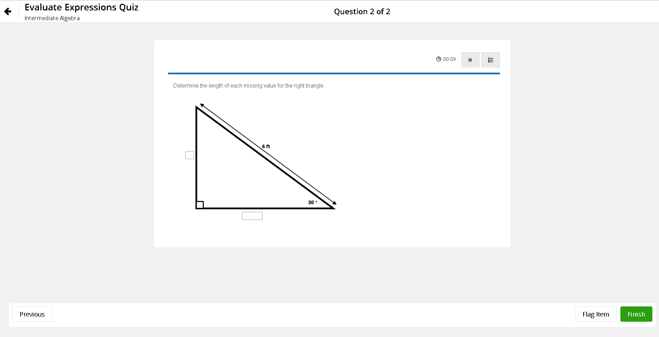
Online Student Testing Interface

Slide 46
PowerSchool Analytics Available October 2017

Slide 47
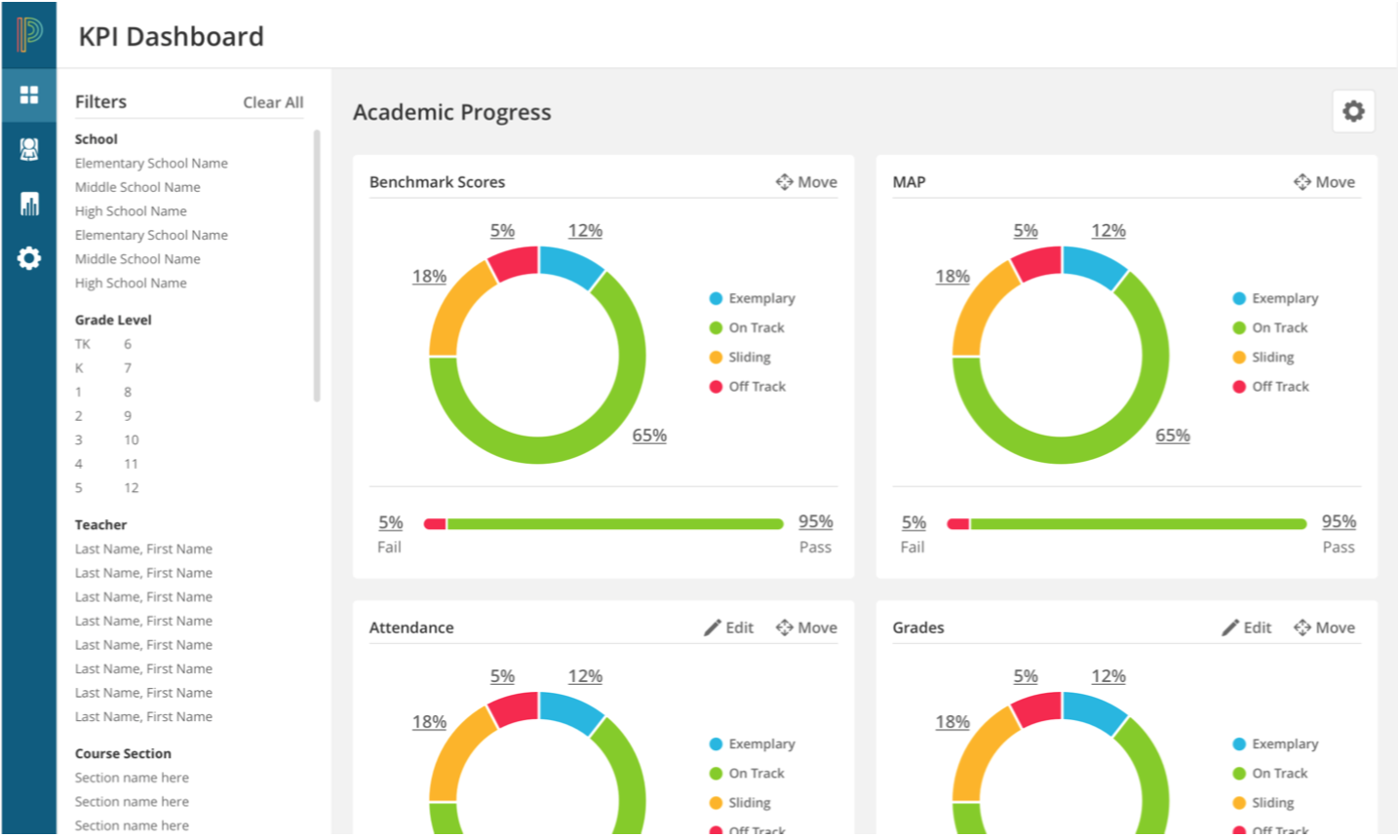
PowerSchool Analytics-October 2017
22

Slide 48
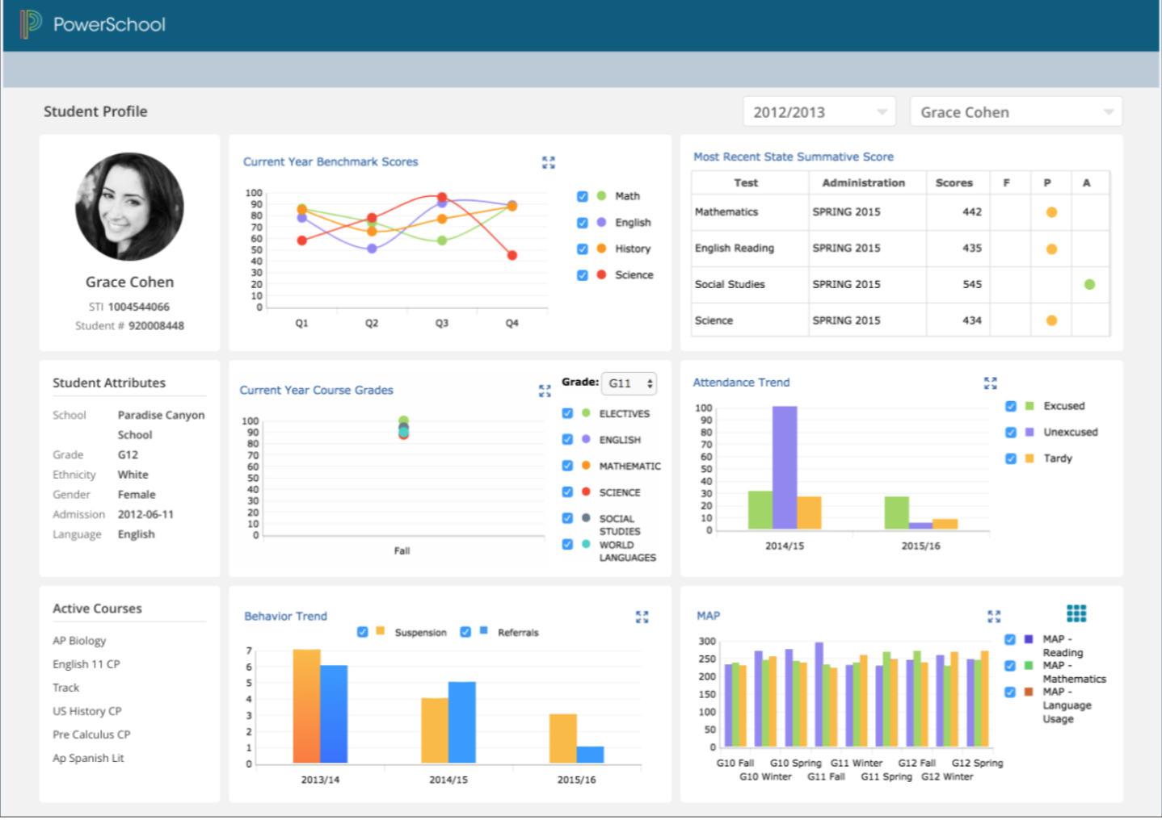
PowerSchool Analytics-October 2017
23

Slide 49
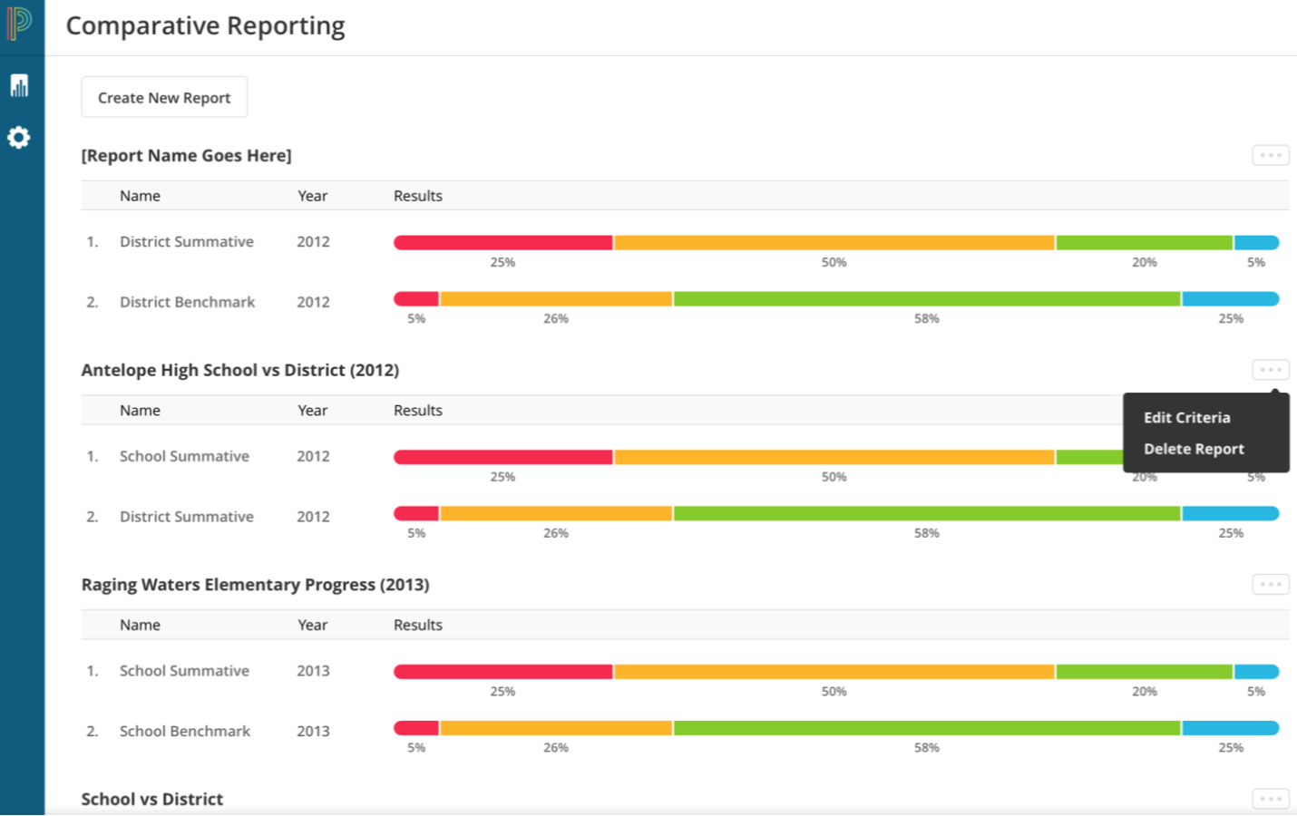
PowerSchool Analytics-October 2017
24

Slide 50
Help
Dashboard > Help

Slide 51
Hands on Activity!

Slide 52
Accessing the Unified Classroom
Navigate to:
classroom.powerschool.com
Notes:
enter notes

Slide 53
Now It’s Your Turn
Review the Dashboard
Take Attendance
Work with a Student
Notes:
enter notes

Slide 54
Now It’s Your Turn
Add an Event to the Calendar
Change view from day to week to month
Post to the Activity Feed

Slide 55
Now It’s Your Turn
Create an assignment
Assign it to all classes
Grade assignment

Slide 56
Now It’s Your Turn
Create an assessment item
Create an assessment

Slide 57
Now It’s Your Turn
Review Class Progress
- Standards and Traditional
Run the Scoresheet Report

Slide 58
Now It’s Your Turn
Log in as a student
View Assignments
Navigate to other classes

