Slide 1
PowerSchool Unified Classroom District Training Fall 2017
Trainer Name(s)
Notes:
As of 8-23-17
NOTE: Portions highlighted in green must be set by district – edit to enter your specific district settings.

Slide 2
Agenda
What is Unified Classroom?
Getting started with the updated PowerTeacher Pro (PTP) Gradebook
Coming soon: PS Assessment & Analytics
Notes:
enter notes

Slide 3
What is Unified Classroom?
Grades, Attendance and Data in one convenient hub
Unified Classroom
Your Information Hub
Analytics
Attendance
Student Demographics
Gradebook and Progress Monitoring
Standards Progress Monitoring
Assessment

Slide 4
Unified Classroom
Your Information Hub
Analytics
Attendance
Student Demographics
Gradebook and Progress Monitoring
Standards Progress Monitoring
Assessment

Slide 5
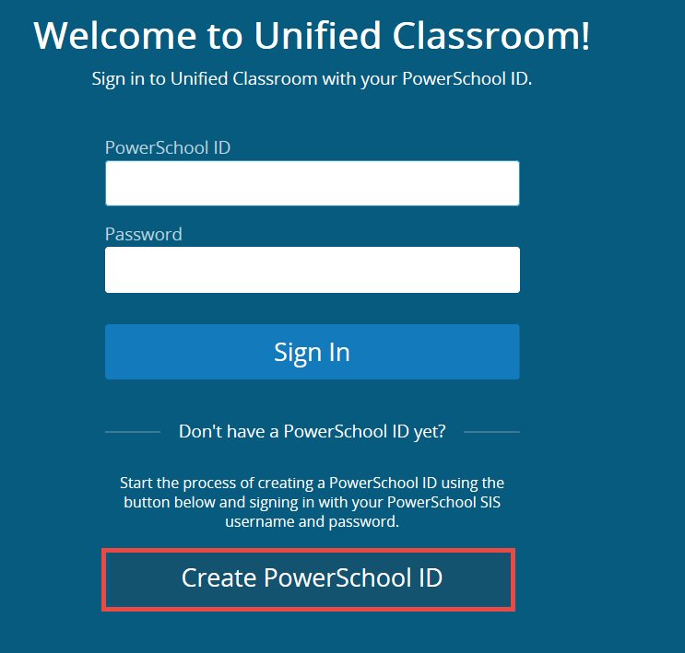
Accessing Unified Classroom
1. Go to the “old” PowerTeacher login at: https://ps.XXX.misd.net/teachers/pw.html
2. Follow the prompts to set up a new login

Slide 6
Signing In
After setting up your new PowerSchool ID you will log in at https://classroom.powerschool.com
Update your Favorites or create a Desktop Shortcut to easily access this site

Slide 7
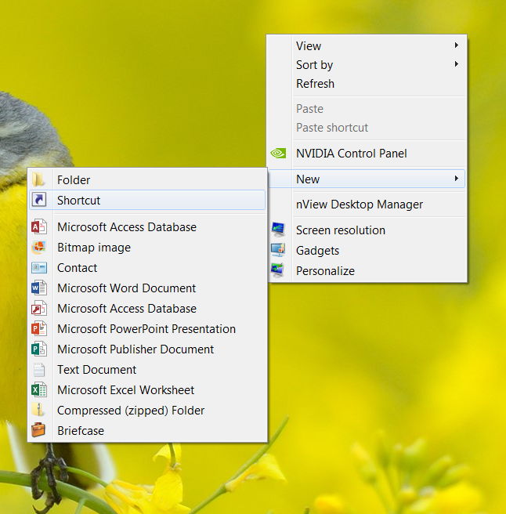
Signing In
Create a Desktop Shortcut to Unified Classroom
Do this on your Teacher computer, not a student computer
Copy the URL from Staff Links or the web address bar
Right click on your desktop
Choose New → Shortcut
Paste the address when prompted

Slide 8
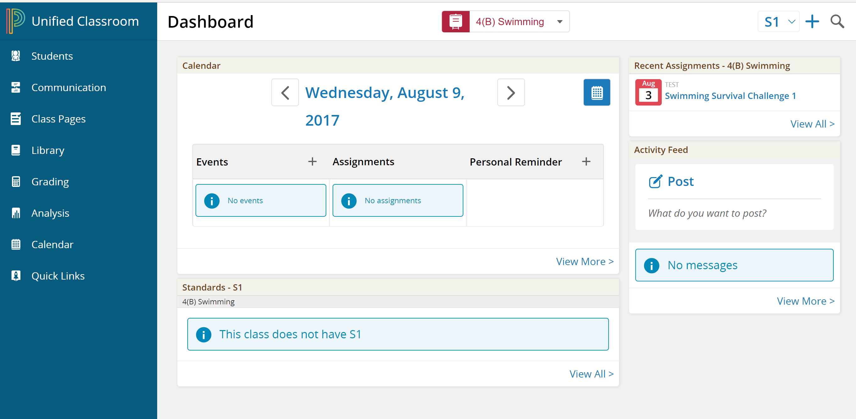
Unified Classroom Homepage

Slide 9
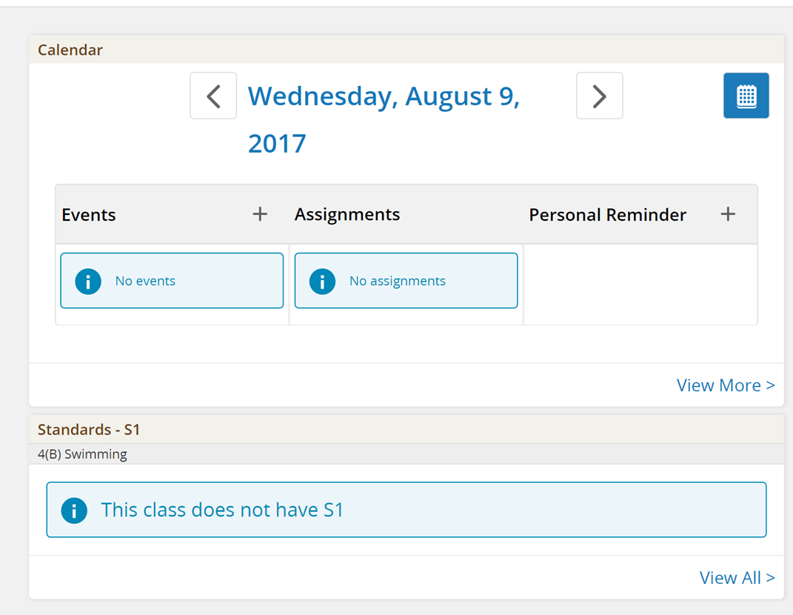
Unified Classroom Homepage
Events, Assignments & Personal Reminders

Slide 10
Unified Classroom Homepage The Calendar
Events –
Assignments –
Personal Reminders –
Appear as posts in the Parent / Student Portal – they are public
Populates automatically when you create an assignment, can be seen in the Parent / Student Portal
Are your private reminders, not seen in the portal

Slide 11
The Parent Portal
We are not updating the Parent / Student portal at this time
Until we can document and provide instructions for the community we do not want to change their end of the portal
That means these public Posts and Events don’t work quite yet
We will provide instructions for parents when their new portal is turned on and we will be sure to tell you

Slide 12
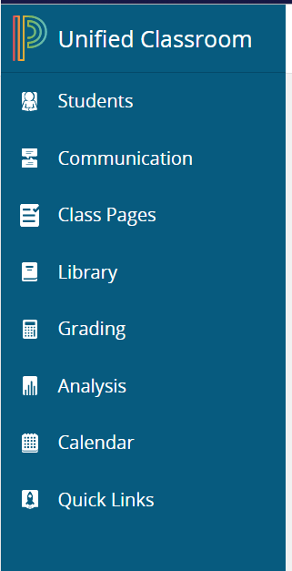
Unified Classroom Homepage
Click the P to return to your homepage at any time.

Slide 13
Individual Student: Demographics
Find individual student demographics and check individual progress under the Students Tab

Slide 14
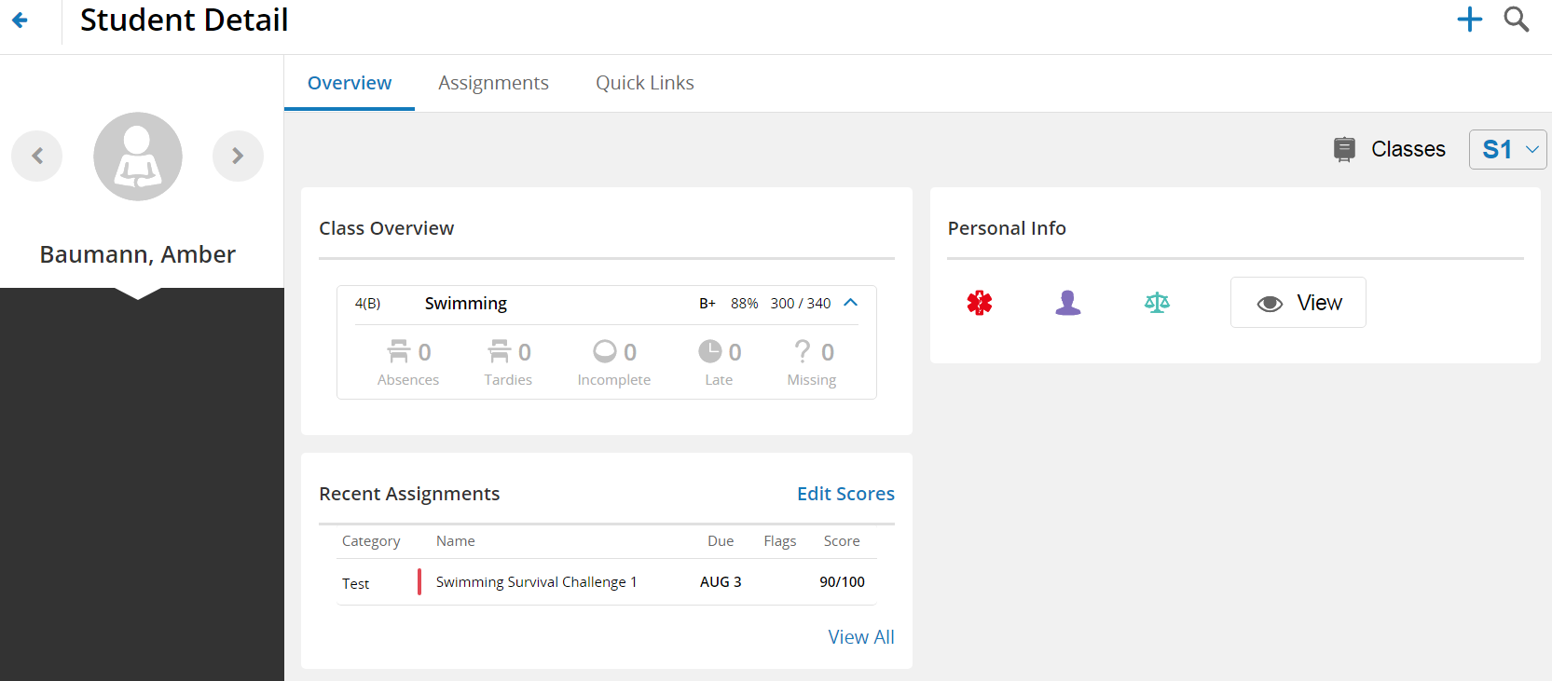
Individual Student: Demographics
Student Details Page displays personal and grade information in a single screen

Slide 15
Taking attendance
Choose a class from the dropdown menu at the top of the page

Slide 16
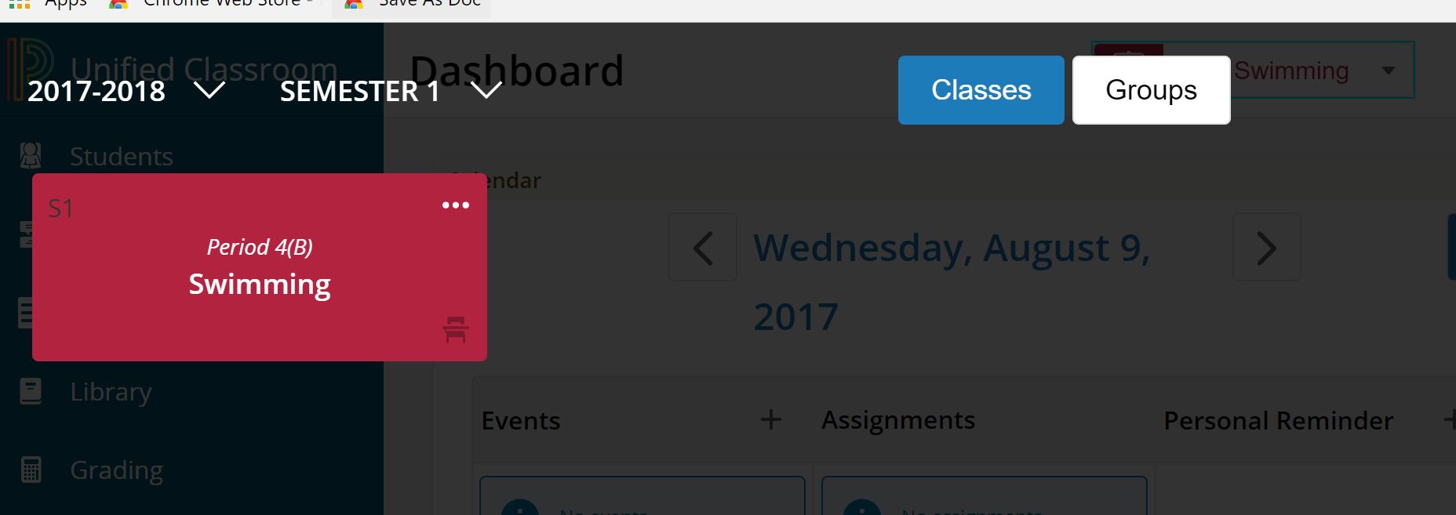
Taking attendance
Click the chair to bring up the attendance page

Slide 17
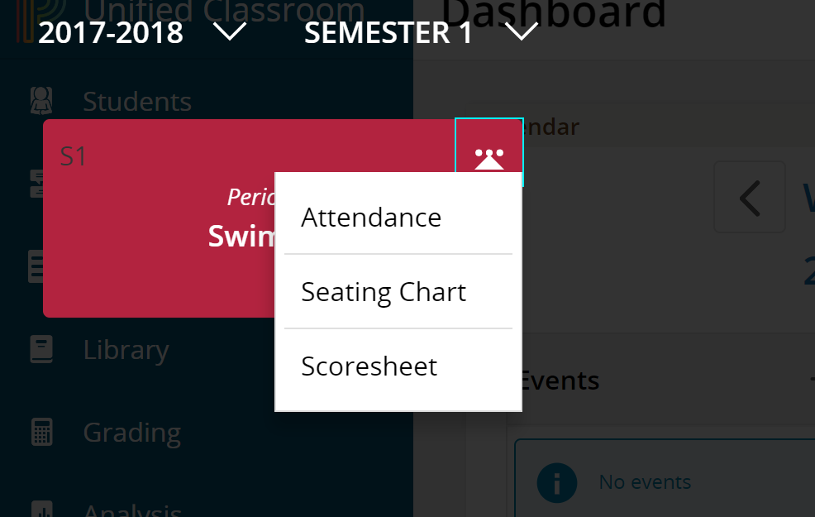
Taking attendance
Attendance page stays the same
Click the “…” for more options

Slide 18
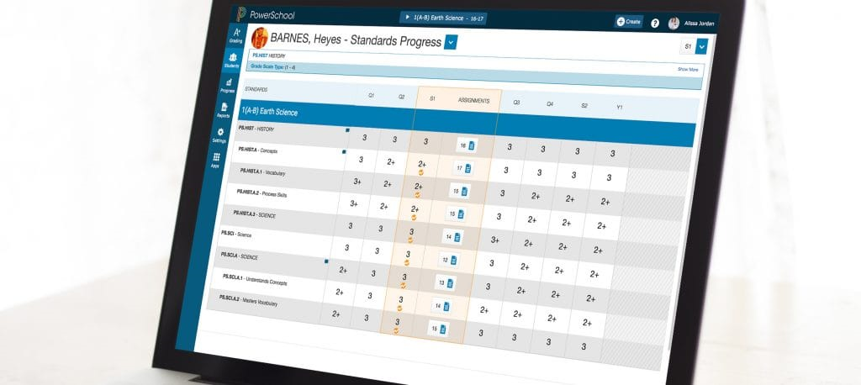
PowerTeacher Pro (PTP) The Updated Gradebook

Slide 19
PTP is simply a facelift to the PowerTeacher Gradebook
Great new features, but works very much like PTG
The new gradebook is HTML based
It opens in your internet browser, no Java install needed
Works on any internet connected device
On an iPad or other mobile device, open PTP in Safari rather than the limited function app.

Slide 20
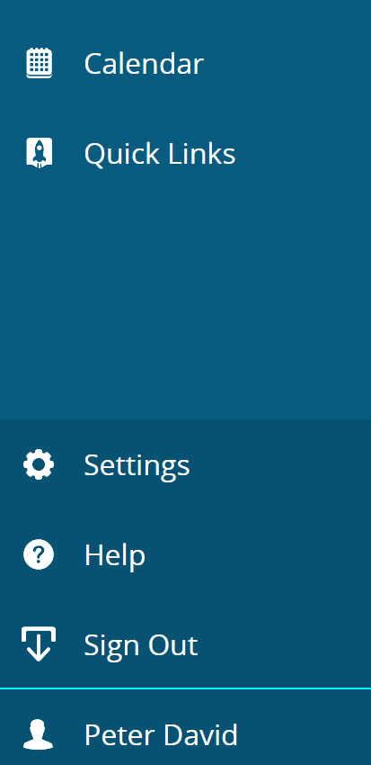
Setting Up Your Gradebook
Click your name at the bottom left
Click Settings

Slide 21
Settings Page

Slide 22
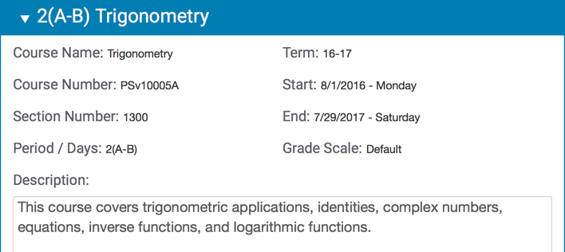
Viewing and Adding Class Descriptions
View class details and add a customized description or syllabus.
Elementary Specials Teachers add custom class names here.
This screen is not usually used by other teachers.
Settings > Class Descriptions

Slide 23
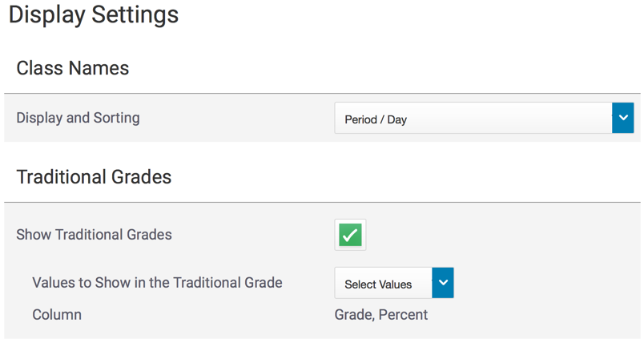
Setting Up Display Preferences
Customize the display settings to control how you view information in your gradebook.
Settings > Display Settings

Slide 24
Setting Up Display Preferences
Customize the display settings to control how information appears in your gradebook.
Elementary Specials Teachers set gradebook to display your custom names here.
Settings > Display Settings

Slide 25
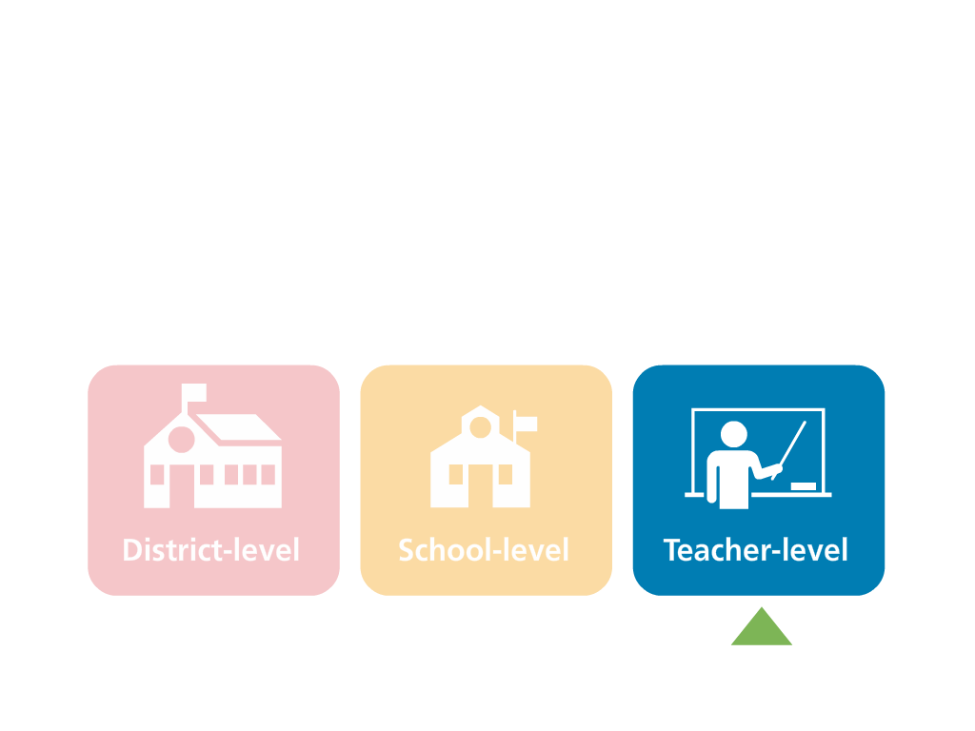
Grading Preferences
Teachers may configure traditional grade calculations for each section they teach
Total Points or Category Weighting
Teachers can edit weights and dropped score preferences

Slide 26
Default Preferences Traditional Grades Preferences (HS only)
District Defaults Here
A note about custom grade scales
-Teachers cannot create custom grade scales in PTP
Settings > Traditional Grade Calculations
Se

Slide 27
CVS Default Preferences Traditional Grades Preferences (ELEM)
District Defaults Here
Elementary Note – Traditional grades can be turned off here (K, 1, Specials).
Settings > Traditional Grade Calculations
Se

Slide 28
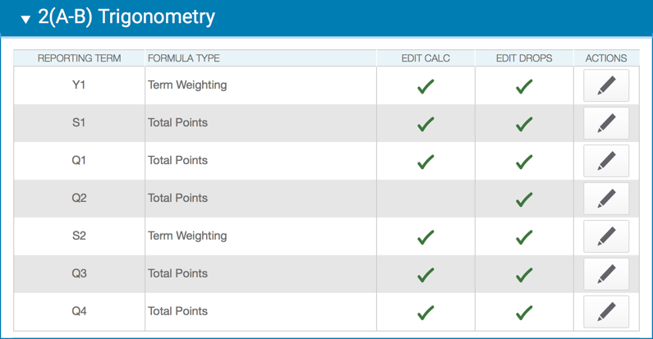
Traditional Grade Calculation Settings
For each class, configure traditional grade calculations for each reporting term
Click Pencil to Edit
Settings > Traditional Grade Calculations

Slide 29
Traditional Grade Calculation Settings
Traditional Grade Calculation Settings can be copied to other sections using the gear icon on the Setting page.
Settings > Traditional Grade Calculations

Slide 30
Traditional Grade Calculation Settings
Semester Term Weighting (40%, 40%, 20%) has been pushed out to all sections
You will not need to manually set this up each semester
The setup can be edited by teachers
Settings > Traditional Grade Calculations

Slide 31
District Defaults Standards Grade Preferences
District Defaults Here
These can be changed under Settings → Standards Grade Calculation
Settings > Standard Grade Calculations

Slide 32
Now It’s Your Turn
Set up your Display Settings
Set up Grade Calculations
Set up Preferences for your Classes

Slide 33
Working with the Grading Spreadsheet Categories and Assignments

Slide 34
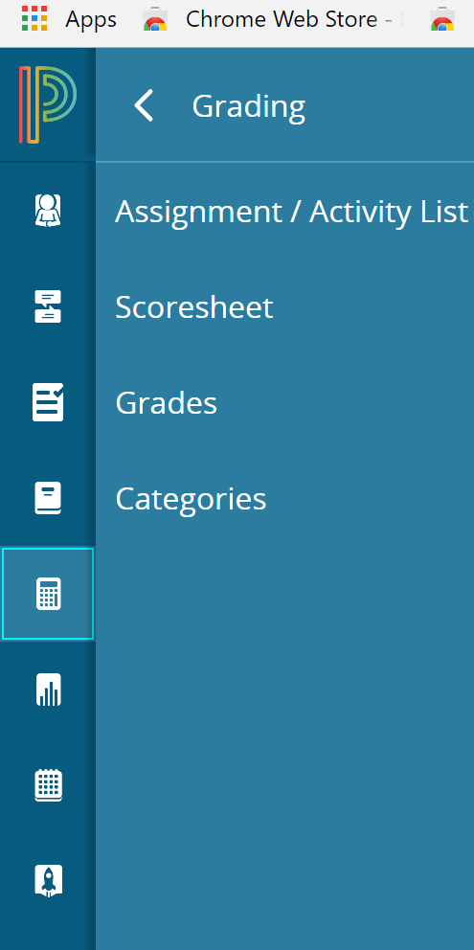
Accessing Categories
Grading > Categories

Slide 35
Creating Categories
Use categories to group assignments by type – they are for organization
Four default categories have set up by the district (NEW)
District Categories Here
Teachers may create and edit additional categories
Teachers cannot edit District Categories, but they can be made inactive
You cannot create a category with the same name as a district category

Slide 36
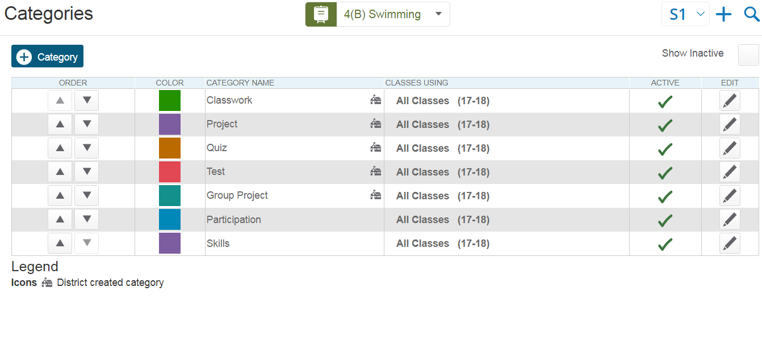
Viewing and Editing Categories
Create a new Category
Sort the list of categories
View district-created categories
Edit a category
Grading > Categories

Slide 37
The Scoresheet and assignment list

Slide 38
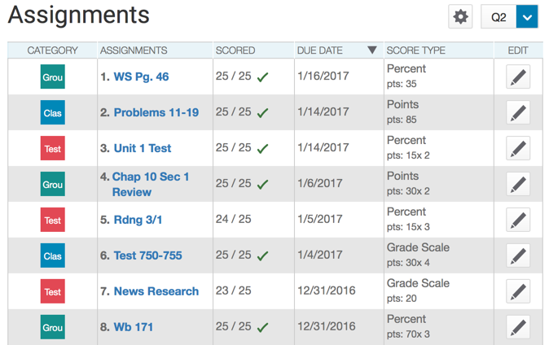
Viewing the Assignment List
Click the pencil to open and edit an assignment on the list
Click the pencil to duplicate the assignment to other sections
Grading > Assignment List

Slide 39
Viewing the Assignment List
New Feature
Assignment list displays if all student work has been scored for each assignment
Grading > Assignment List

Slide 40
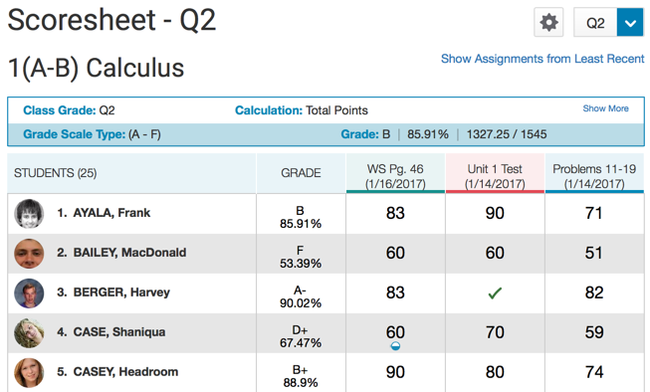
Viewing the Scoresheet (Spreadsheet View)
Grading > Scoresheet

Slide 41
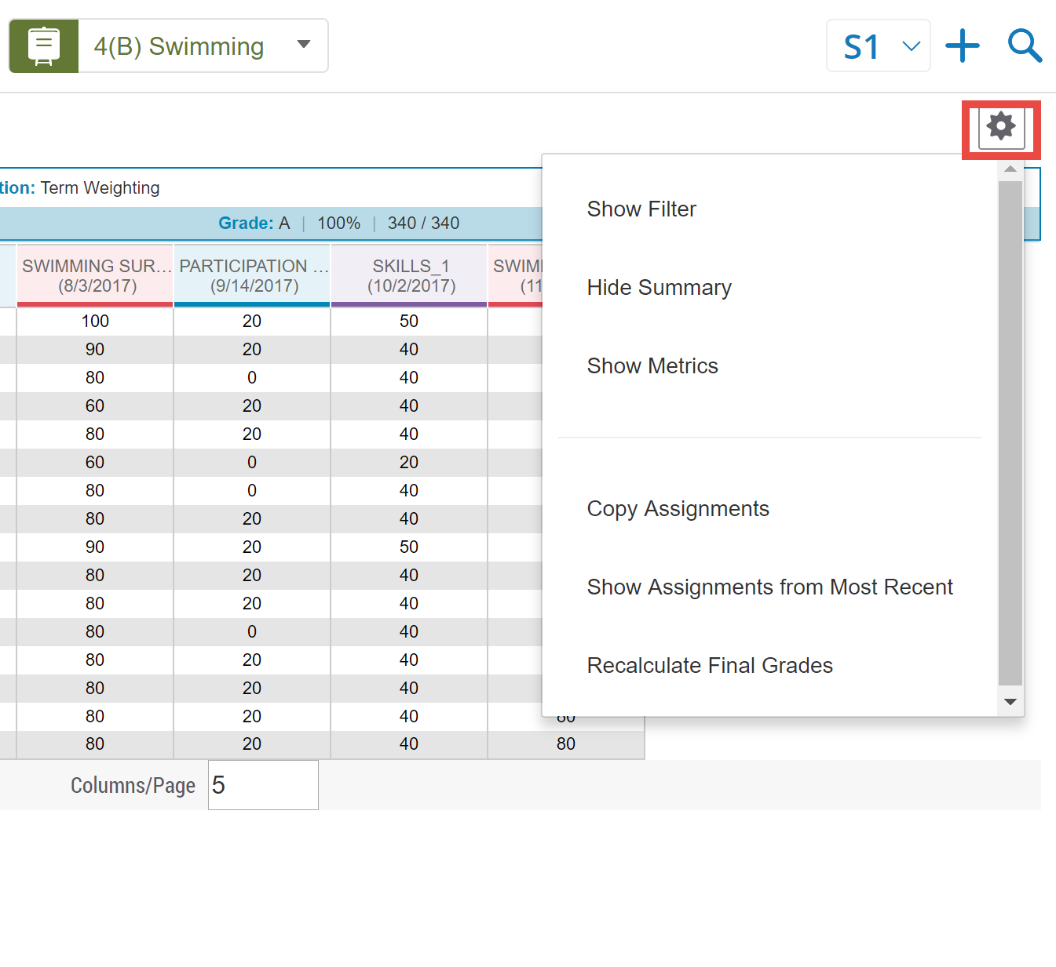
Viewing the Scoresheet
Click the Gear in Scoresheet view to access options.
New Feature:
Show Assignments from Most Recent
Grading > Scoresheet

Slide 42
Creating Assignments from the Scoresheet
Choose reporting term using dropdown at top right
Use + to create a new assignment
(also found on Assignment List View)

Slide 43
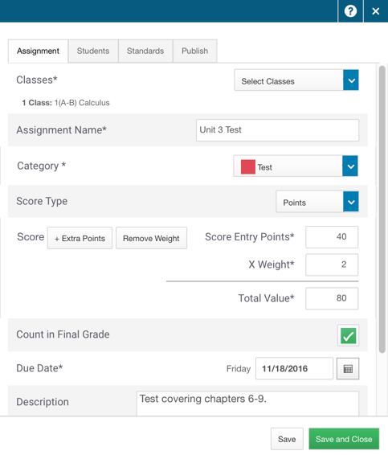
These are the same assignment options you had in the “old” gradebook

Slide 44
Creating Assignments: NEW FEATURES when Creating Assignments
Add assignments to multiple classes when creating
Create assignments for specific groups of students (re-test, extra practice, etc)
These assignments will not even show for the students who are not included in the group.

Slide 45
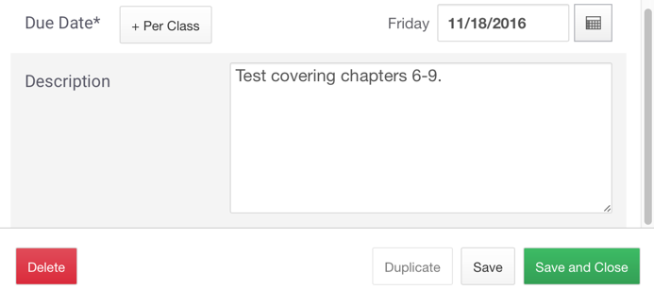
Duplicating Assignments (NEW)
Access from Assignment Edit Screen or Gear at top right of Scoresheet screen

Slide 46
Now It’s Your Turn
Check out the District Categories
Create additional Categories for your class
Start creating assignments for the new year
Practice duplicating assignments
Check out the new student group feature when creating assignments
Notes:
enter notes

Slide 47
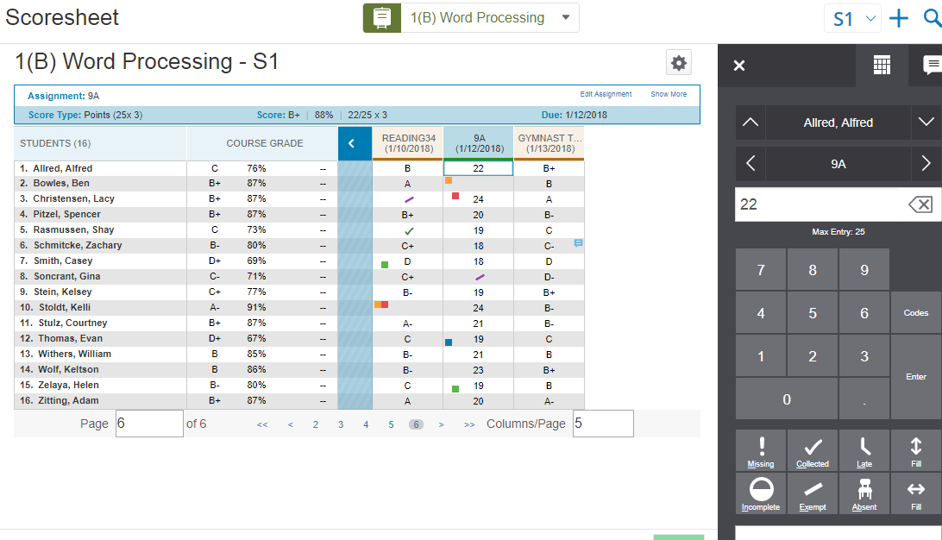
Entering Scores
Enter assignment scores using the laptop keypad or the on screen number pad.

Slide 48
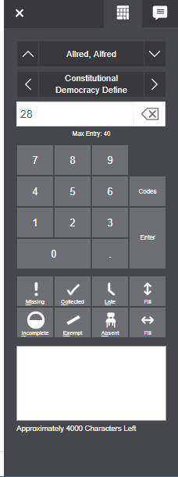
The Score Inspector
Access score codes and assignment comments directly from the Score Inspector
Grading > Scoresheet > (select a score cell)

Slide 49
Fill Scores
Fill all students’ scores for one assignment
Fill all assignment scores for one student

Slide 50
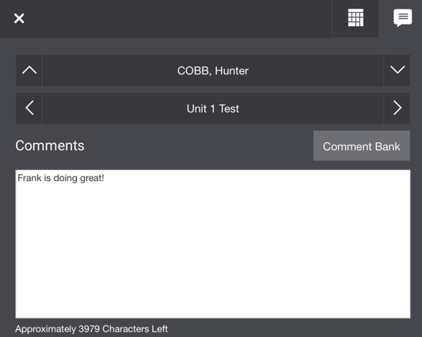
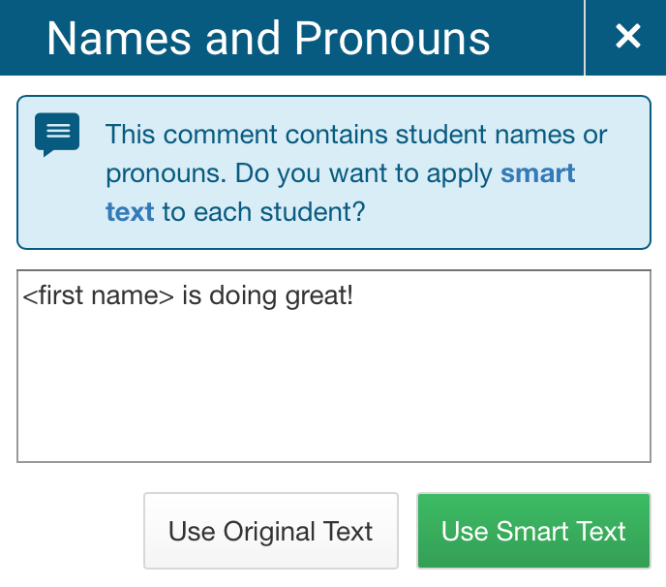
Add Comments (for an assignment)
Enter comments manually or use the comment bank
Use the smart text feature to personalize comments for one or more students (NEW Feature)
Enter a student’s name, then fill the comment to all empty cells to trigger the smart text function.
Grading > Scoresheet > (select a score cell) > Comment icon

Slide 51
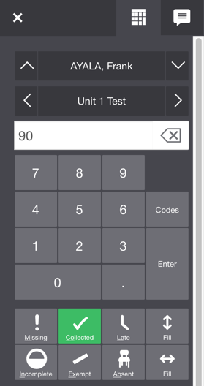
A Note About Score Codes and Special Codes
Special Codes: -Are found on the Score Inspector
-Do not affect grades, just a visual cue (exception = Exempt)
Score Codes:
-Codes that define a grade
-For now must be created by the district
Grading > Scoresheet > (select a score cell)
Notes:
NOTE for presenters: Please share that Sarah will be sending a survey about which score codes need to be created and use that information to set them up. Watch for the survey coming later this week.

Slide 52
Now it’s Your Turn
Try out these activities:
Create a Category that Will Not Count in the Final Grade (works like a checklist - NEW)
Mark an Assignment as Late
Duplicate an Assignment and Assign it to Individual Students
Create an Extra Credit Assignment

Slide 53
Quick Review (time permitting)

Slide 54
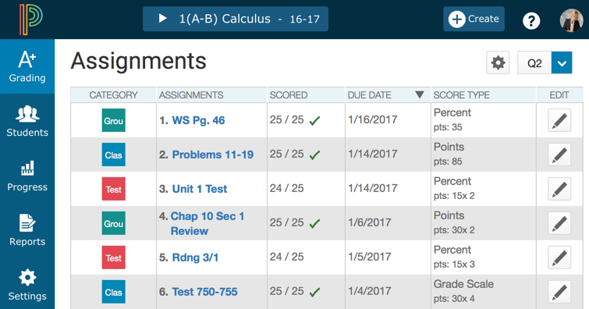
Question 1
Where do you click to add a new assignment?
}
#1
{
#2

Slide 55
Answer 1
Where do you click to add a new assignment?

Slide 56
Question 2 - Matching
Match the flag or icon with its definition.
A
1
Indicates that an assignment is exempt
Answer 1
B
2
Indicates that an assignment is incomplete
Answer 2
C
3
Indicates that a comment was added
Answer 3
D
4
Indicates that an assignment is late
Answer 4

Slide 57
Answer 2 - Matching
Match the flag or icon with its definition.
(Matching colors are correct pairs)
A
1
Indicates that an assignment is exempt
B
2
Indicates that an assignment is incomplete
C
3
Indicates that a comment was added
D
4
Indicates that an assignment is late

Slide 58
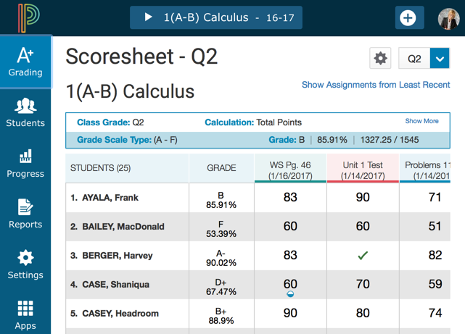
Question 3
Where do you click in PowerTeacher Pro to begin the process of adding a class description?

Slide 59
Answer 3
Where do you click in PowerTeacher Pro to begin the process of adding a class description?

Slide 60
Question 4
Which of the following options can you use to save time when creating assignments?
A
B
Duplicate existing assignments
Create assignments for course groups
C
D
Create assignments for all classes
Copy assignments across terms

Slide 61
Answer 4
Which of the following options can you use to save time when creating assignments?
A
B
Duplicate existing assignments
Create assignments for course groups
C
D
Create assignments for all classes
Copy assignments across terms

Slide 62
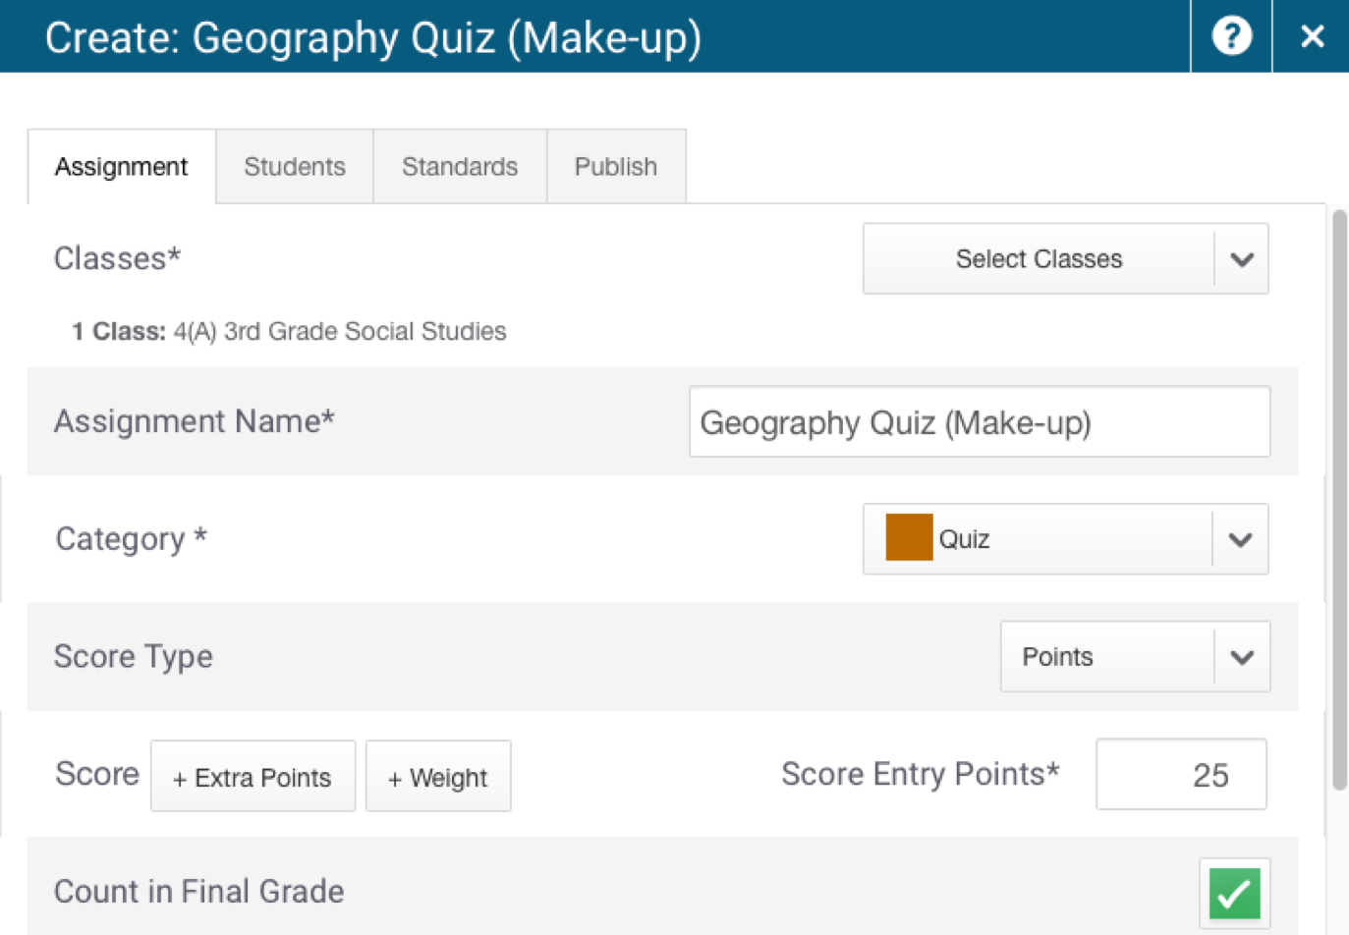
Question 5
Where do you click to apply an assignment to a selection of students?

Slide 63
Answer 5
Where do you click to apply an assignment to a selection of students?

Slide 64
Working with Final Grades
Notes:
enter notes

Slide 65
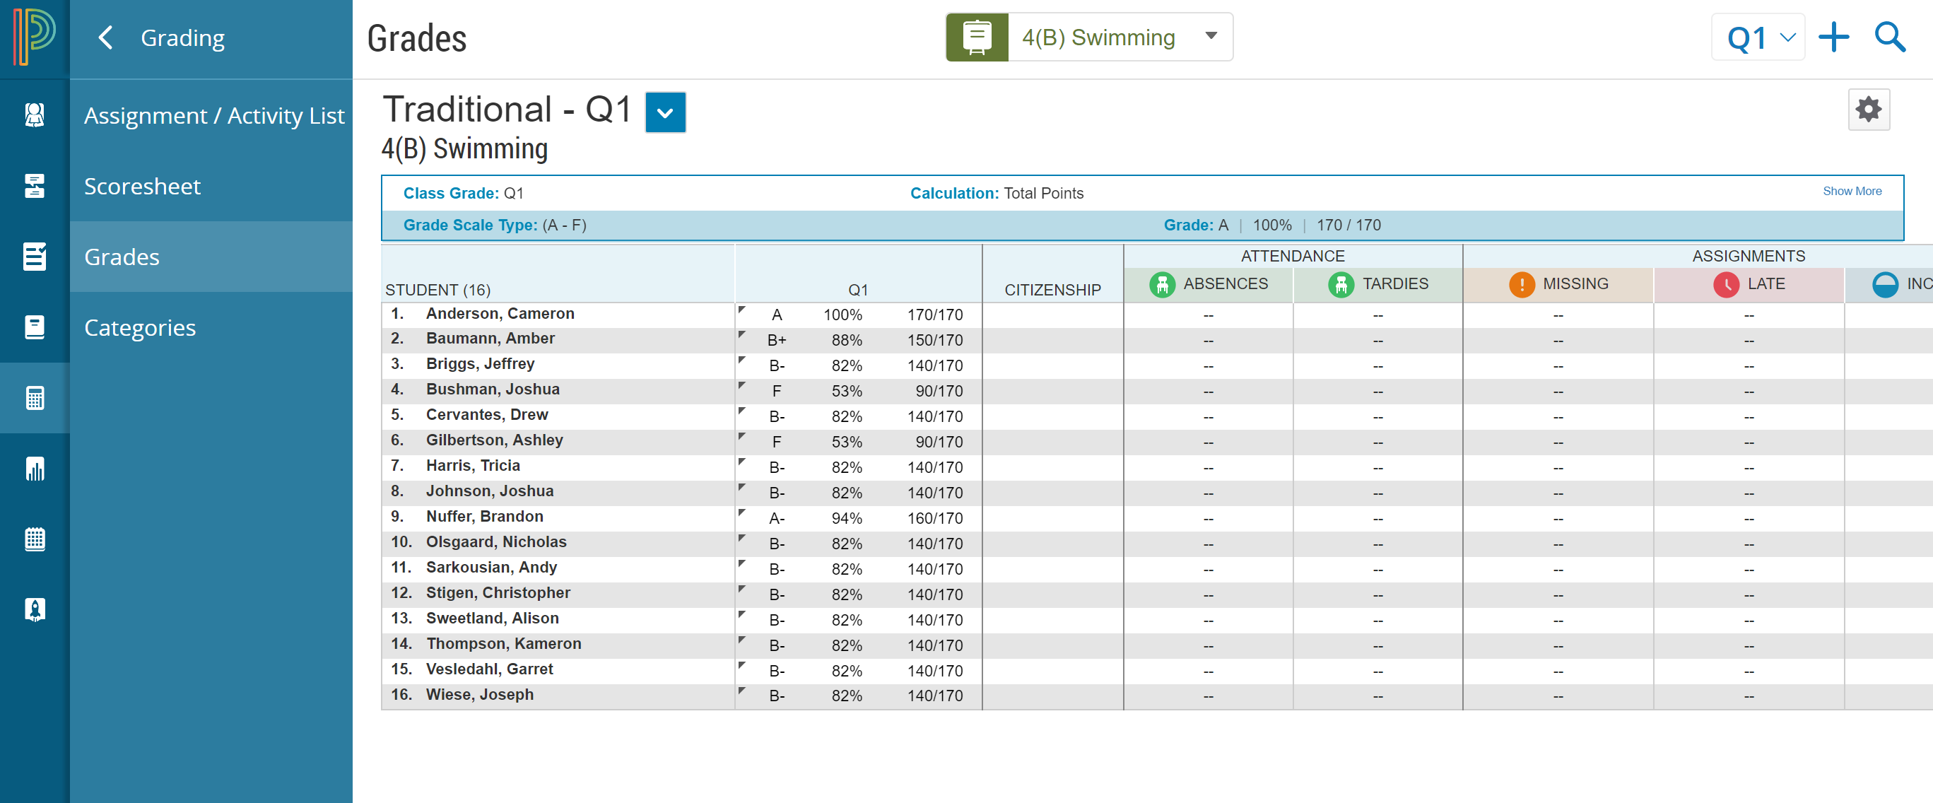
Final Grades: Traditional
View traditional grades for a class, enter citizenship scores, and view a summary of how many absences, tardies, missing assignments, late assignments, and incomplete assignments each student has.
Grading > Grades

Slide 66
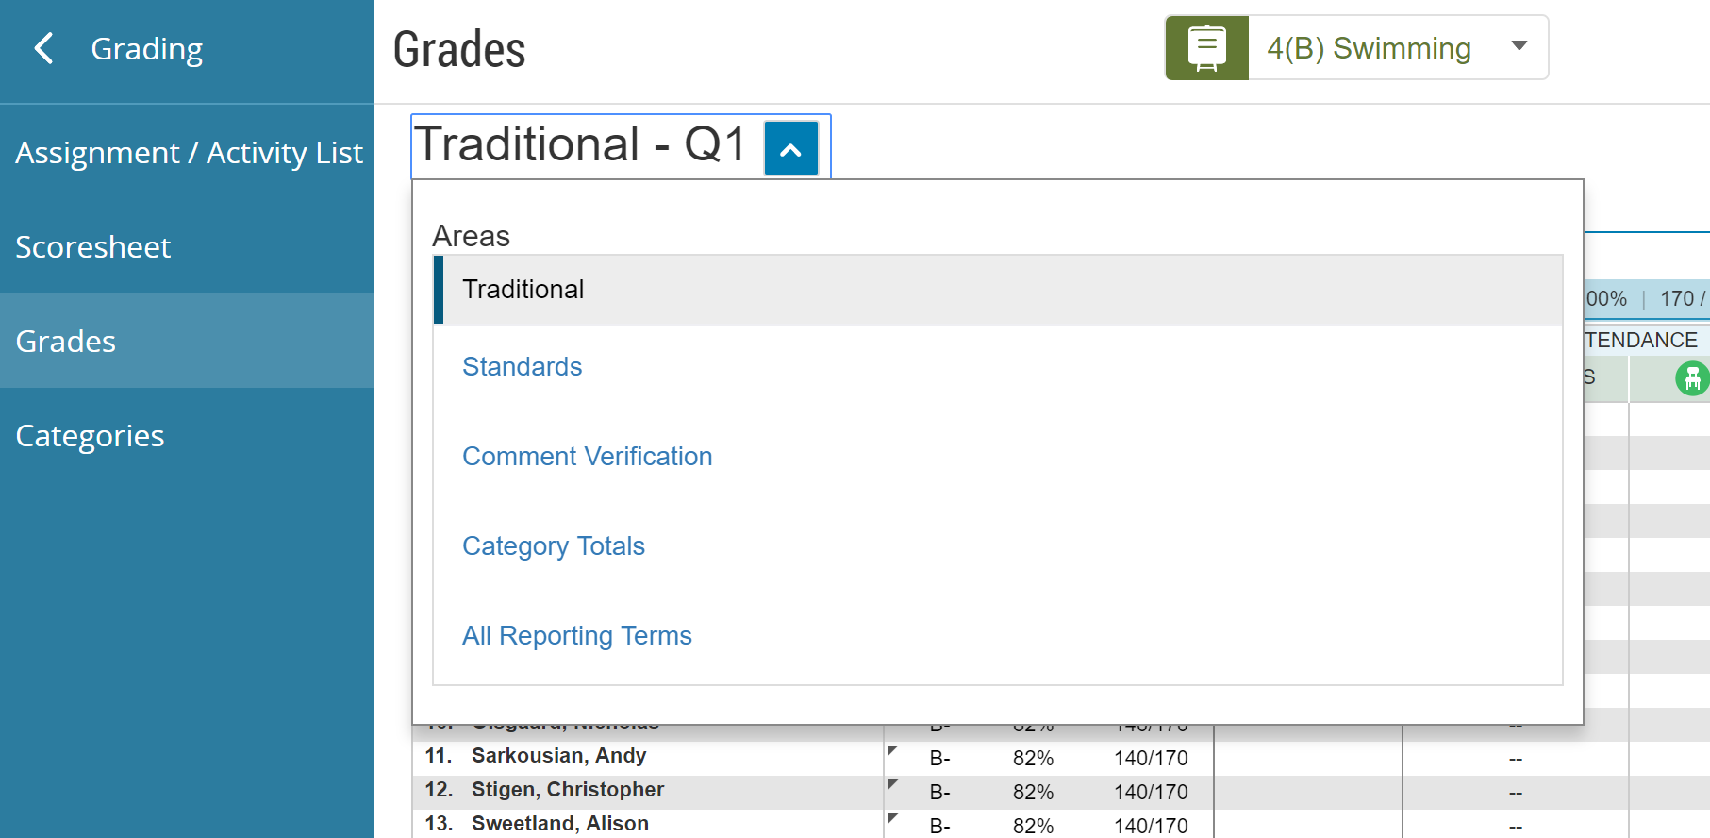
Final Grades: Standards (ELEM & MS Only)
View and edit standards grades for a class by choosing Standards from the dropdown menu.
Grading > Grades

Slide 67
Comment Verification
View and edit final grades comments.
Grading > Grades

Slide 68
Comment Verification
View and edit final grades comments.
Grading > Grades

Slide 69
Category Totals
View a summary of students’ grades by assignment category.
Grading > Grades

Slide 70
All Reporting Terms
View and work with students’ final grades from all terms.
Grading > Grades

Slide 71
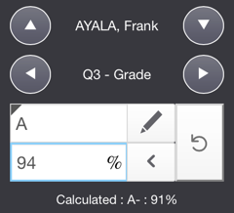
Modified Final Grades (Manual Override)
A triangle indicates that the final grade was modified.
The Score Inspector shows the modified and calculated grades.
Undo the modification to revert to the calculated grade.

Slide 72
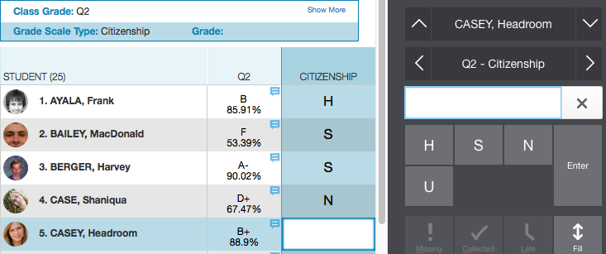
Enter Citizenship Scores
Enter citizenship scores on the Grades page to be printed on students’ report cards.
Grading > Grades

Slide 73
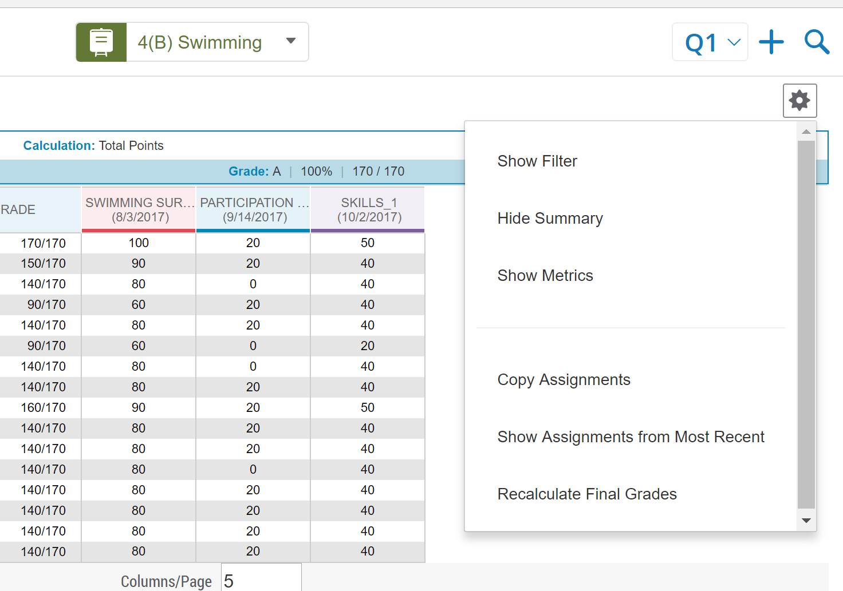
Recalculate Final Grades
Recalculate final grades to ensure that any calculation changes administrators may have made appear in your gradebook, or if you change any grading standards after starting the grading period.
Grades > Scoresheet

Slide 74
Important Note re standards:
If adding standard after entering assignment grades it does not currently recalculate the grades…must re-key in scores
We have reported this issue and hope to have a fix soon

Slide 75
End of Term
Grades > Scoresheet

Slide 76
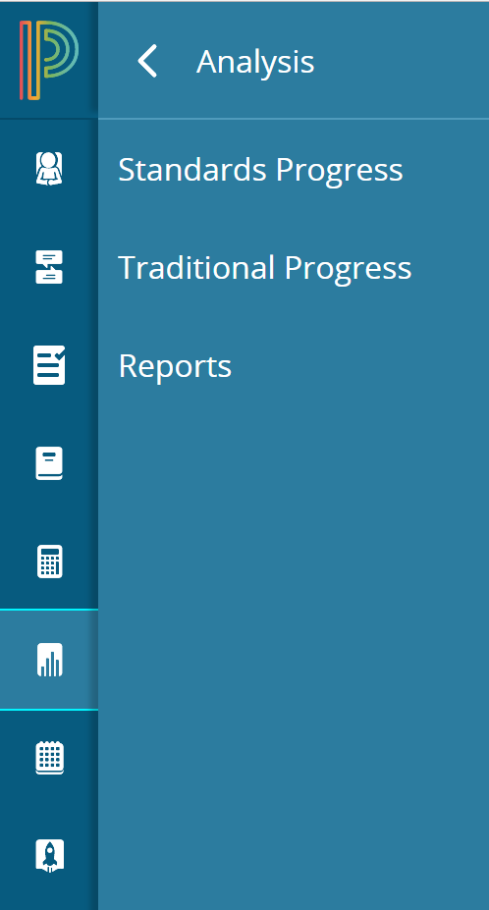
Reports
Now housed under Analysis
More Reports are being added

Slide 77
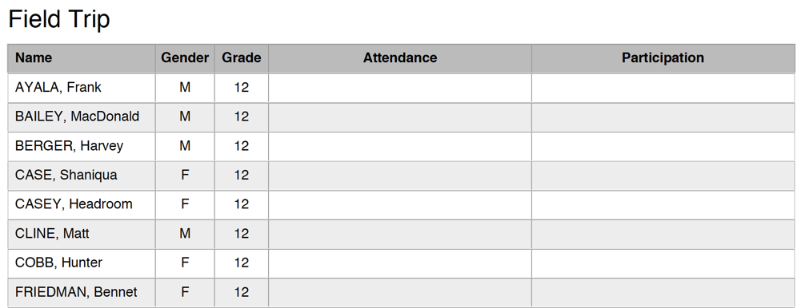
Student Roster Report
This report lists student information on a class roster. Add blank columns with customized headings. Can now be printed Landscape or Portrait (NEW)
Reports > Student Roster

Slide 78
Assessment & Analytics
The Assessment & Analytics portions of UC will be taking the place of Data Director
These portions of the program are still being deployed
Training will be available as these features are rolled out

Slide 79
Assessment
Access in Library Tab
Item bank with 20,000+ items
Create items
60 item types available
Links back to gradebook

Slide 80
Assessment - NOTE
Common assessments have not been moved yet
Please feel free to browse, but do not start creating items yet as the system is still being set up

Slide 81
Analysis
Use the analysis tab to easily review class and individual student progress towards standards
Charts and color coding make your analysis easy

Slide 82
Professional Judgment Indicator (NEW feature)
The Professional Judgment Indicator appears when evidence exists for mastery that may differ from the student’s calculated standard score.

Slide 83
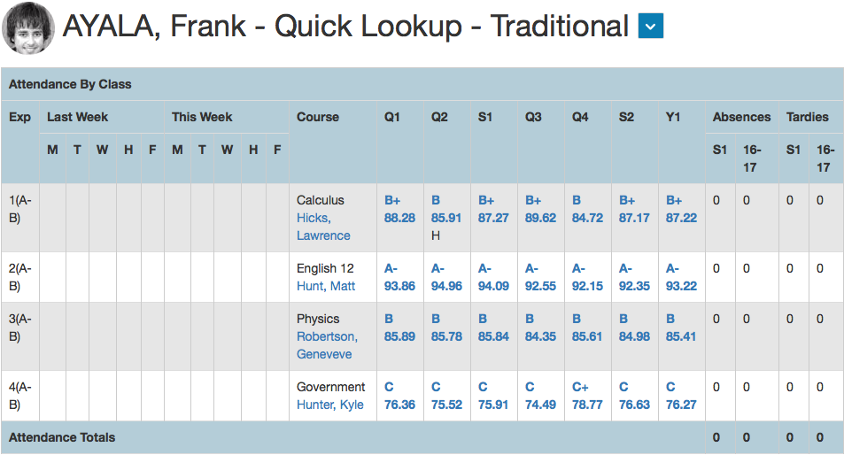
Individual Student: Quick Lookup
View a student’s Quick Lookup pages to view traditional and standards grades.
Students > (select a student) > Assignments > Quick Menu > Quick Lookup - Traditional

Slide 84
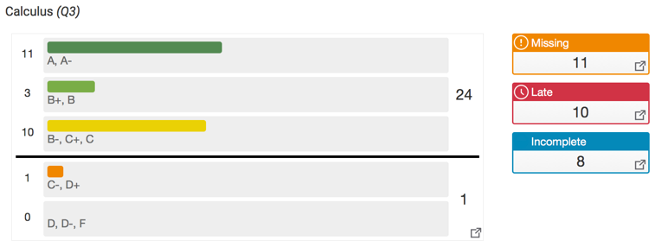
Class Progress: Traditional (NEW Feature)
View the distribution of traditional grades for a class for the selected reporting term.
Analysis > Traditional Progress

Slide 85
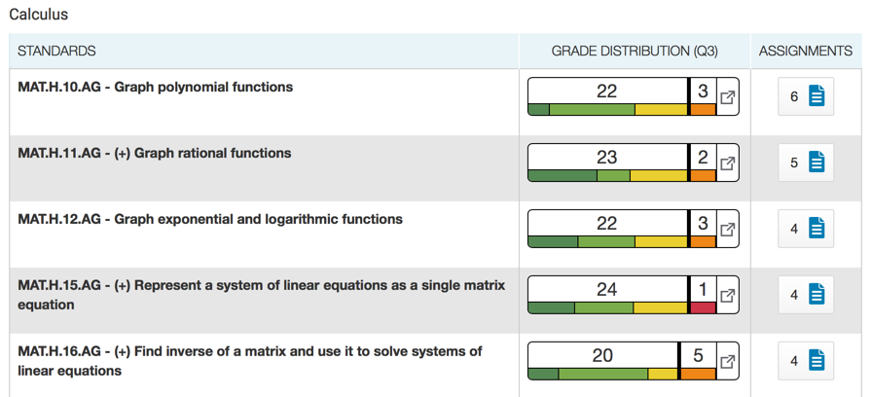
Class Progress: Standards (NEW Feature)
View the distribution of course standards grades for a class for the selected reporting term.
Analysis > Standards Progress

Slide 86
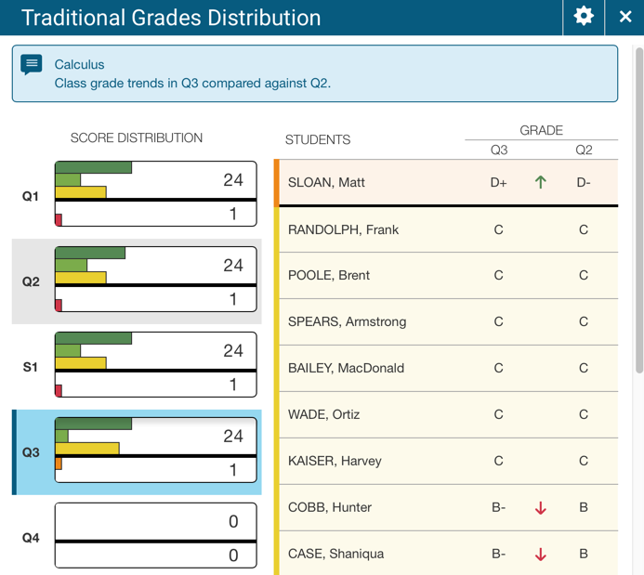
Traditional Grades Distribution (NEW)
View traditional grade distributions by reporting term
Compare class grade trends between terms
View individual student grade trends between terms
Analysis > Traditional Progress > (select the graph)

Slide 87
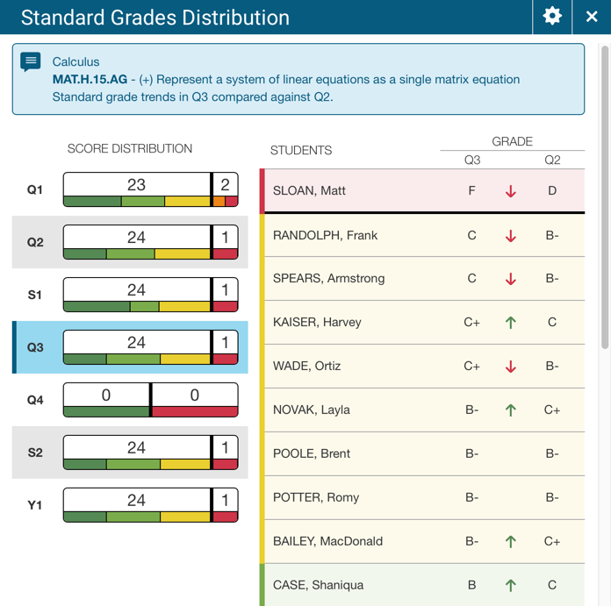
Standards Grades Distribution (NEW Feature)
View standards grade distributions by reporting term
Compare class grade trends between terms
View individual student grade trends between terms
Analysis > Standard Progress > (select the graph)

Slide 88
Take into consideration
Newly released product under development
More training to come

Slide 90
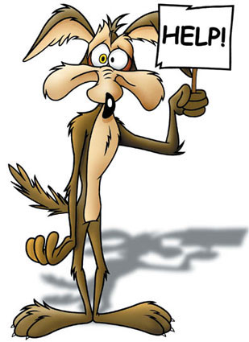
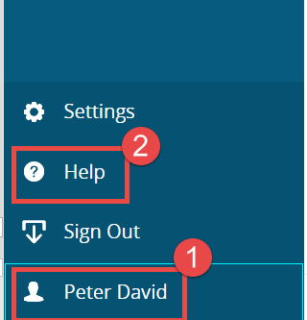
Help Available

Slide 91
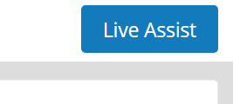
Live Assist
Live Assist will put you in touch with a PS help technician
They can remote onto your computer to help you in real time
7am – 5pm EST

Slide 92
PowerSource
Training Documents and Videos available in PowerSource (https://support.powerschool.com)
Must log in to access – check your email for account login information
Once logged in click Traning → Master in Minutes and enter “Powerteacher Pro” in the search field for a variety of short, helpful videos

Slide 93
PowerSource

Slide 94
What’s Next for Unified Classroom?
Upcoming Training:

